Slide 1
City of Rockport
City Manager’s Monthly Update
July 23, 2024
City Council Regular Meeting

Slide 2
City Manager’s Monthly Update
Development
Financial
Police Department
Projects
Public Works
Human Resources
Parks and Recreation
Upcoming Projects
Miscellaneous

Slide 3
Development
Residential
Daniels Forest Subdivision Preliminary Plat @ 116 Forest Hills will be presented to the P&Z on Monday, July 29,2024.
Commercial
Starbucks @ 2302 Hwy 35 N. and Kokomo 7/11 @ 3588 SH 35 Bypass are completing permit applications.
Short Term Rental
The RentalScape program is in the process of being implemented and expect to be operational by September 1, 2024.

Slide 4
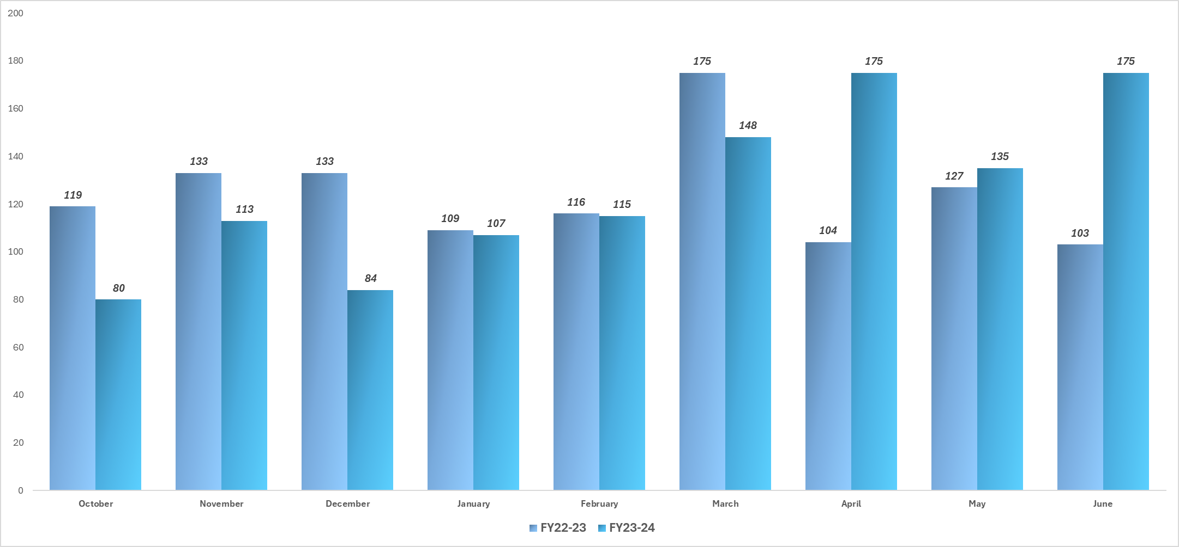
Permits Issued

Slide 5
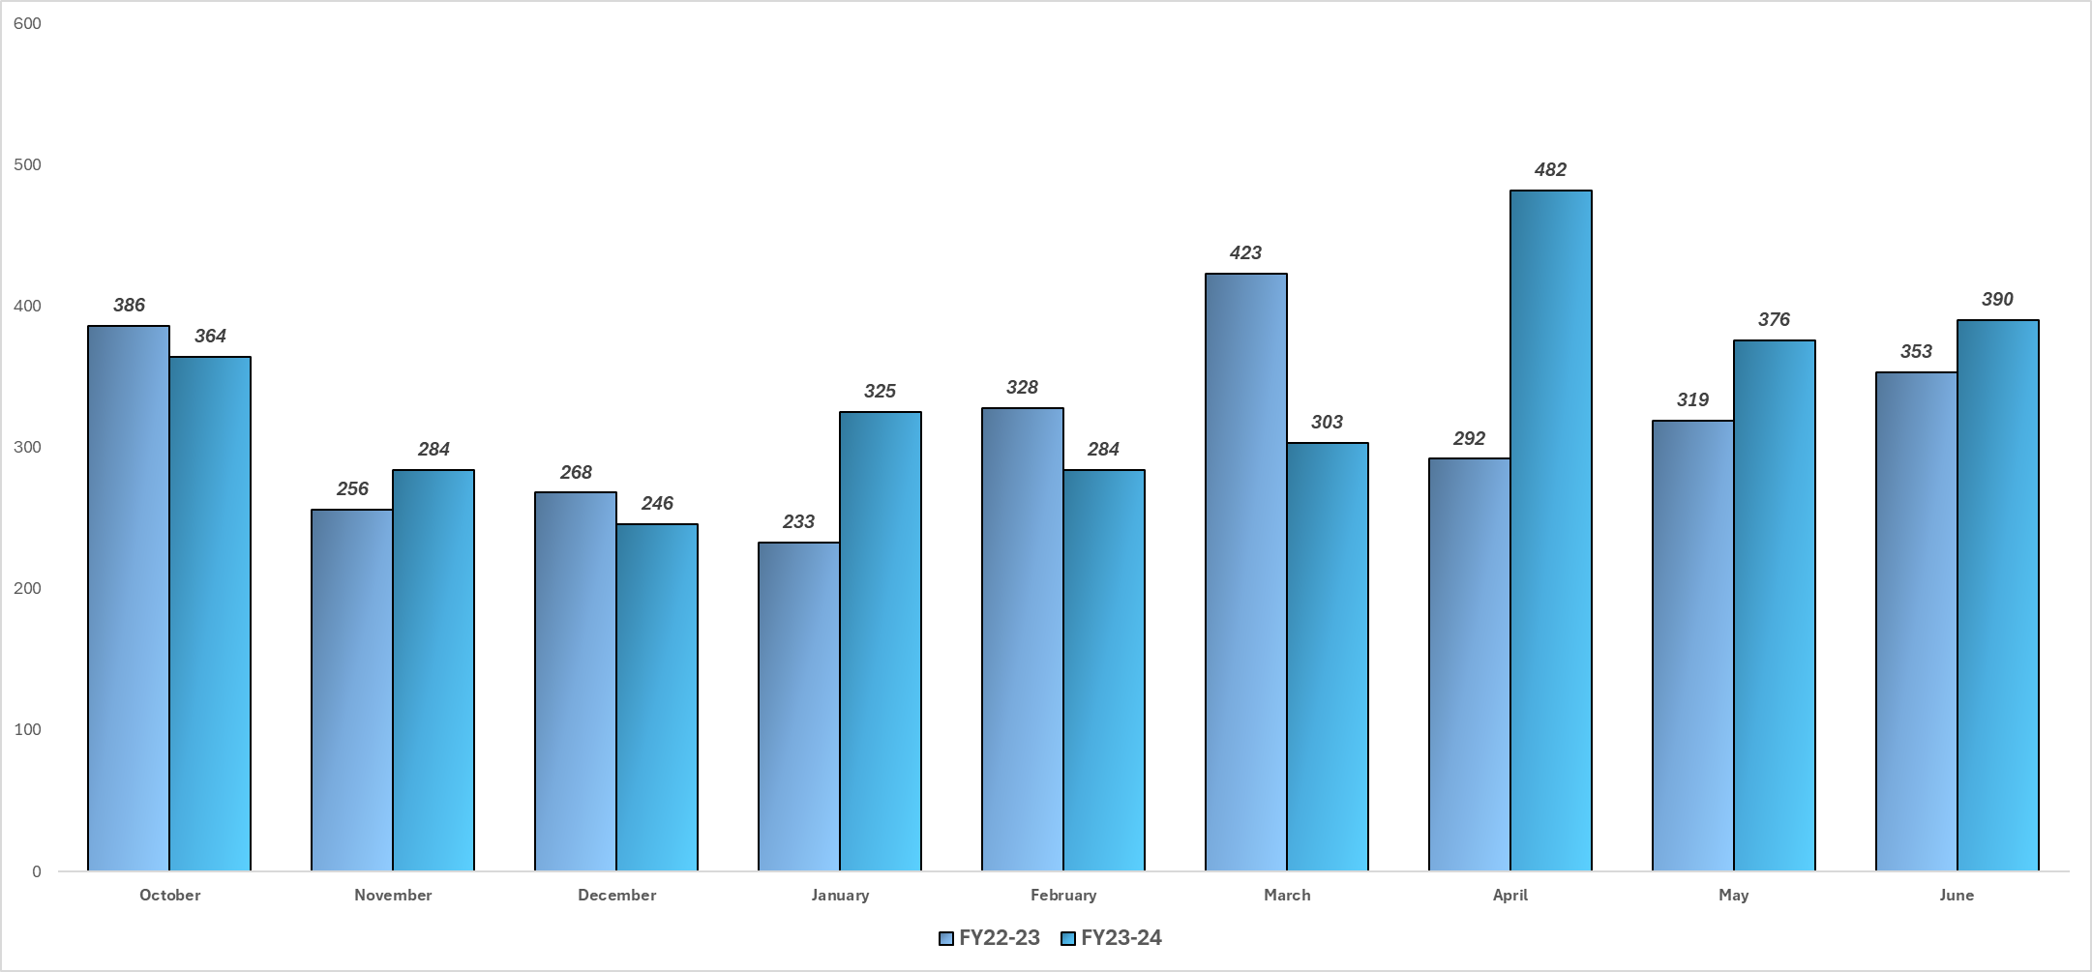
Monthly Inspections

Slide 6
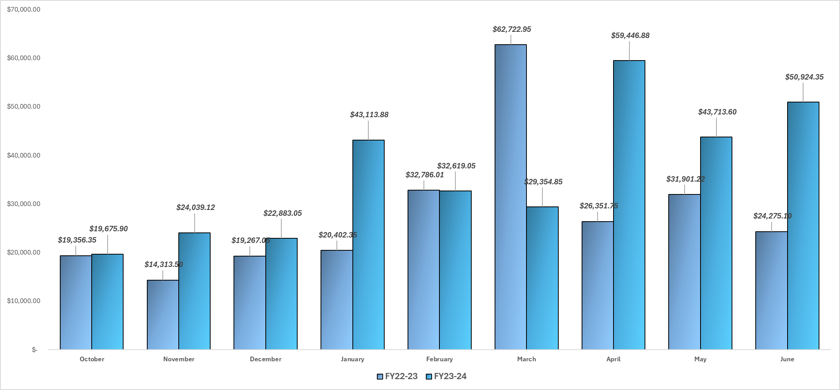
Water & Sewer Impact Fees

Slide 7
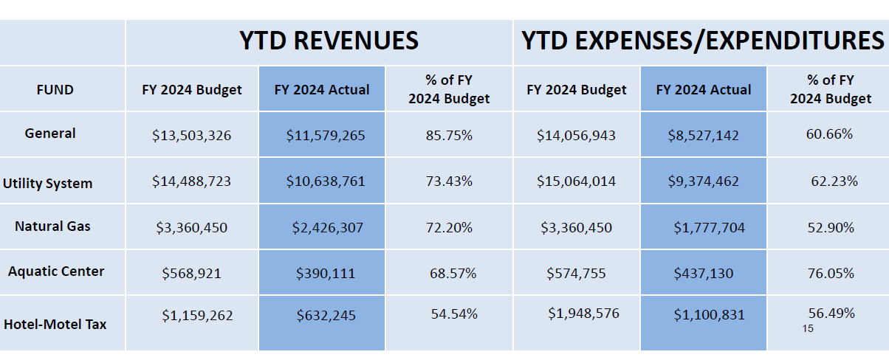
Monthly Financial Report

Slide 8
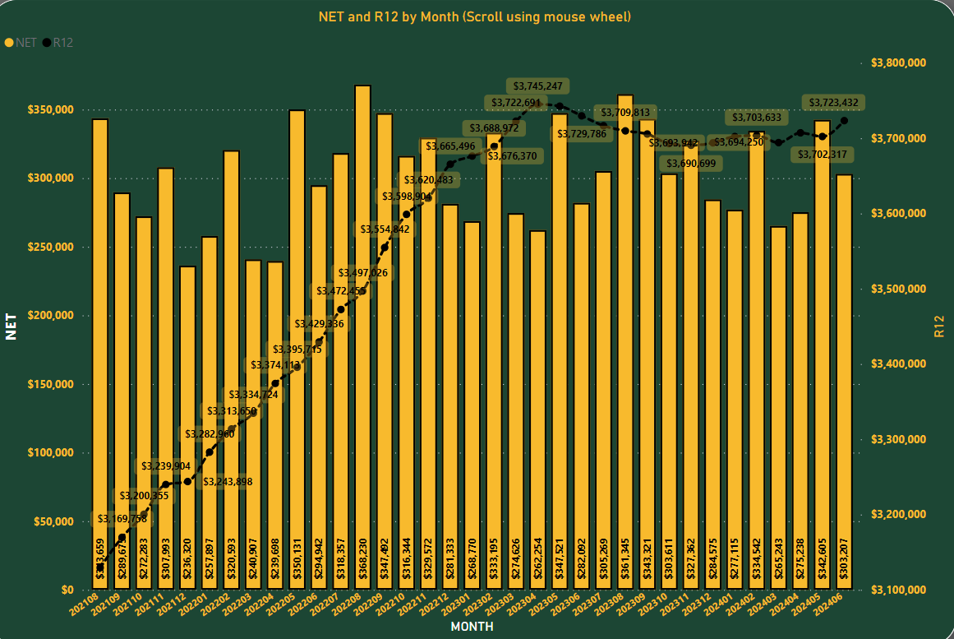
Sales Tax Revenues

Slide 9
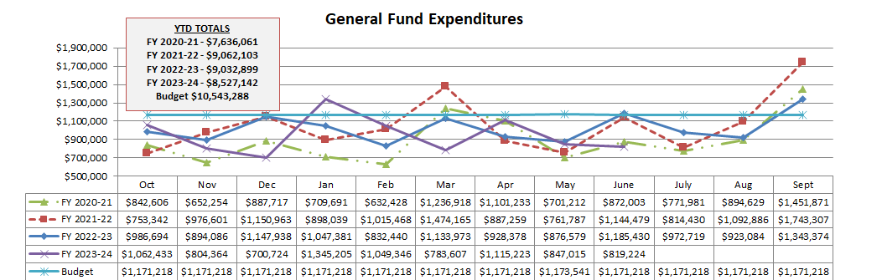
General Fund Expenditures

Slide 10
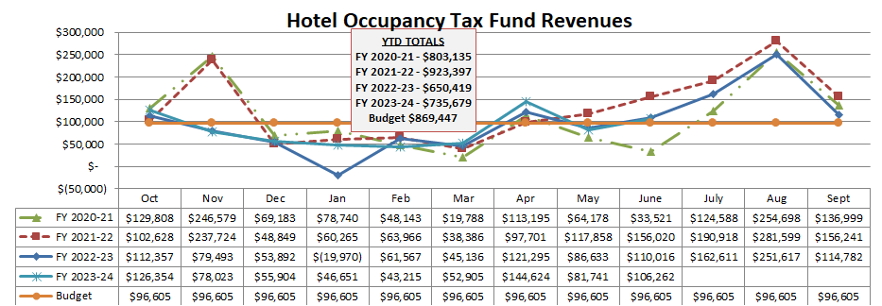
Hotel Occupancy Tax Fund Revenues

Slide 11
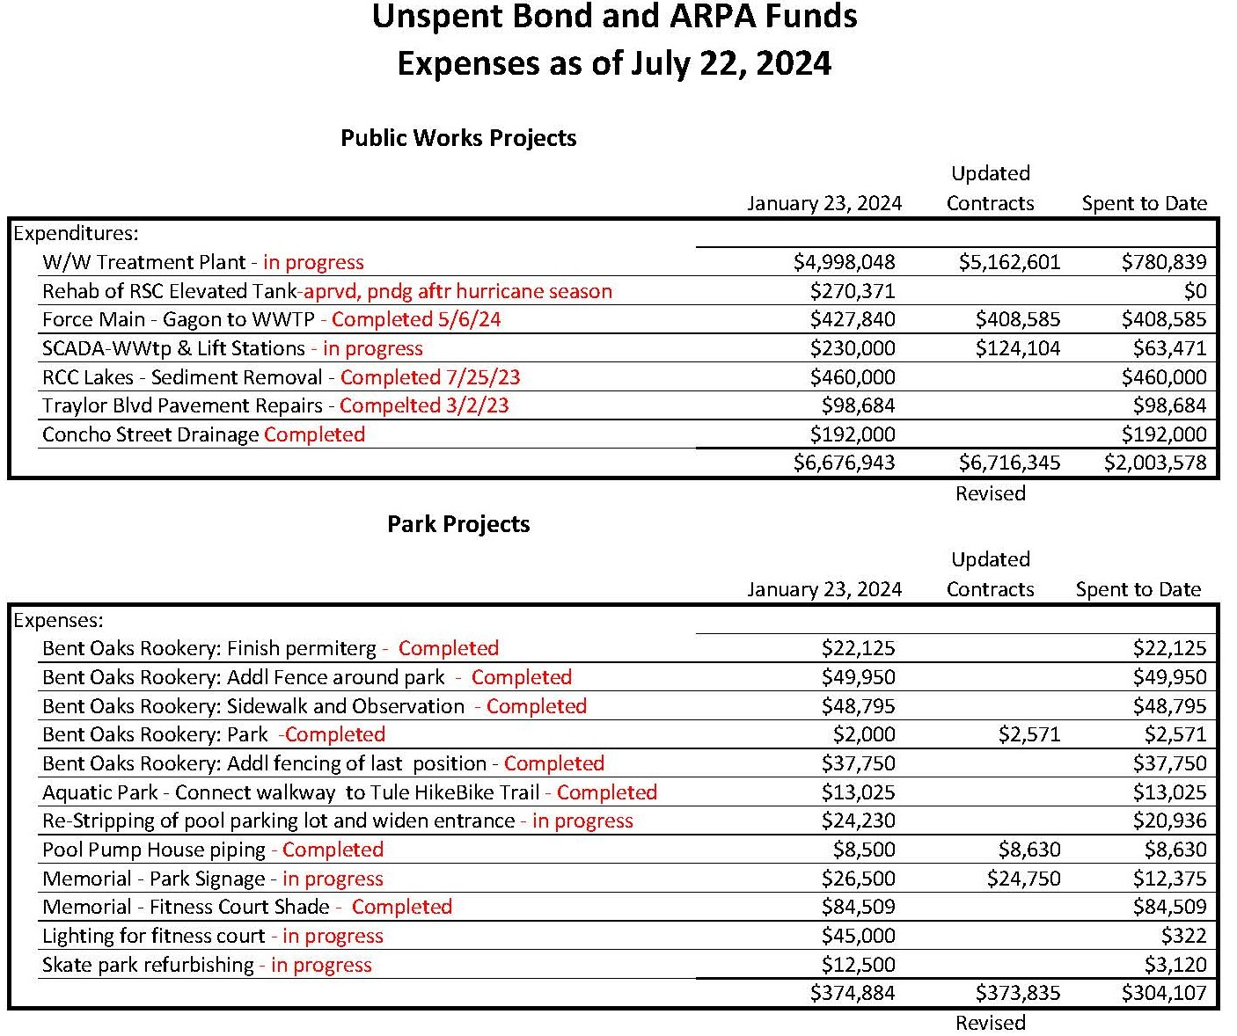
Unspent Bonds

Slide 12
Police Department
JUNE
 | 2023 | 2024
Police Incidents | 103 | 125
Calls for Service | 839 | 657
Arrests | 29 | 55
Traffic Contacts | 238 | 574
Traffic Accidents | 19 | 16
Code Enforcement Complaints | 126 | 121
CID Cases Assigned | 82 | 52
CID Clearance Rate | 28% | 36%

Slide 13
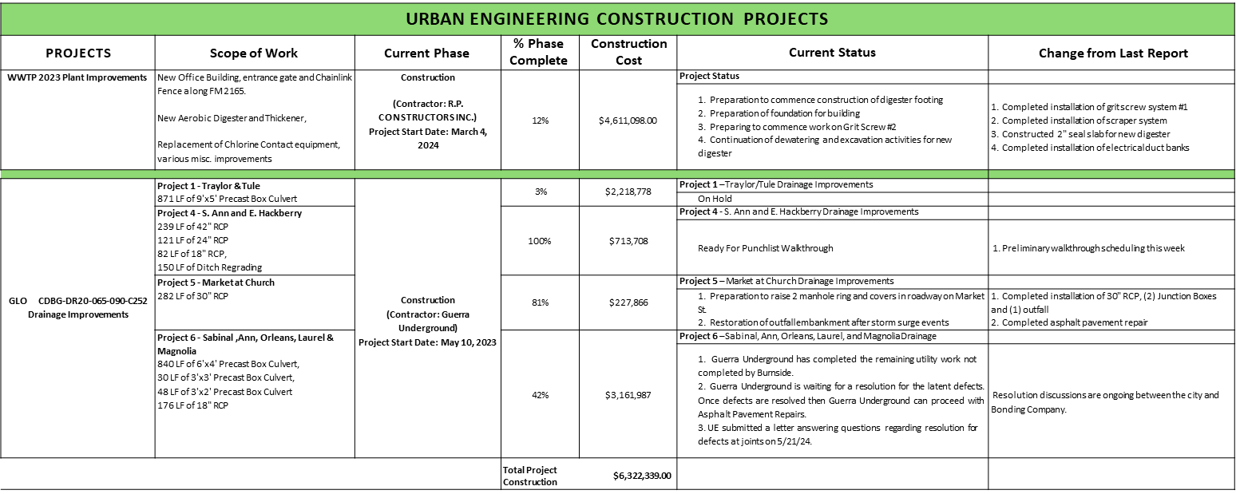
Project Report (Engineer Update)

Slide 14
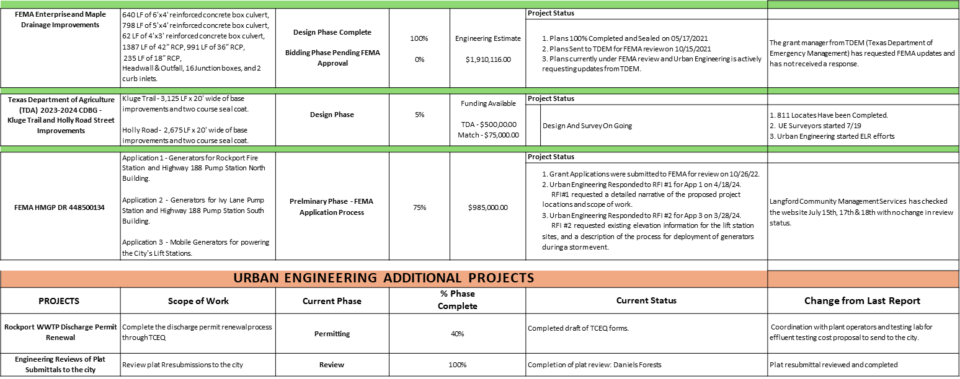
Project Report (Engineer Update Continued)

Slide 15
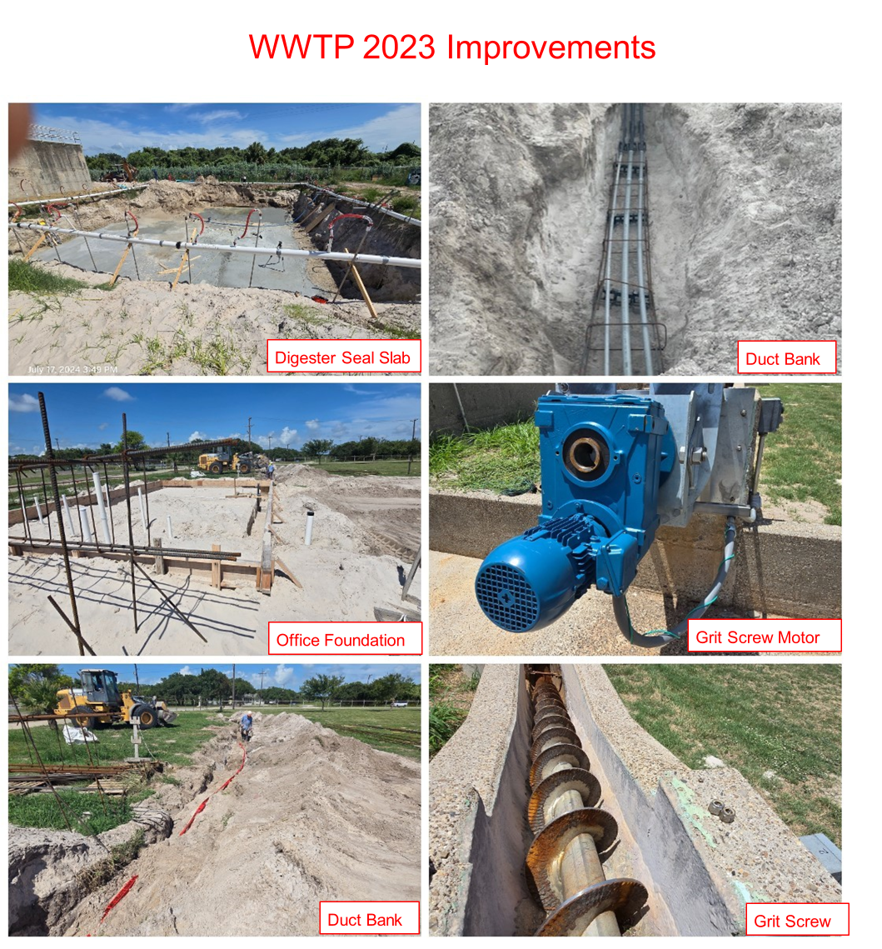

Slide 16
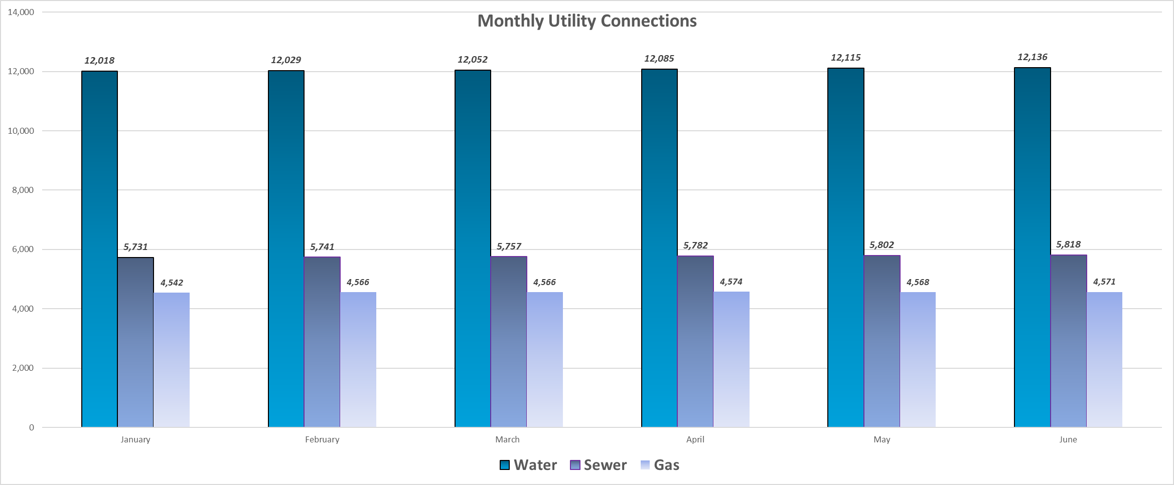
Public Works

Slide 17
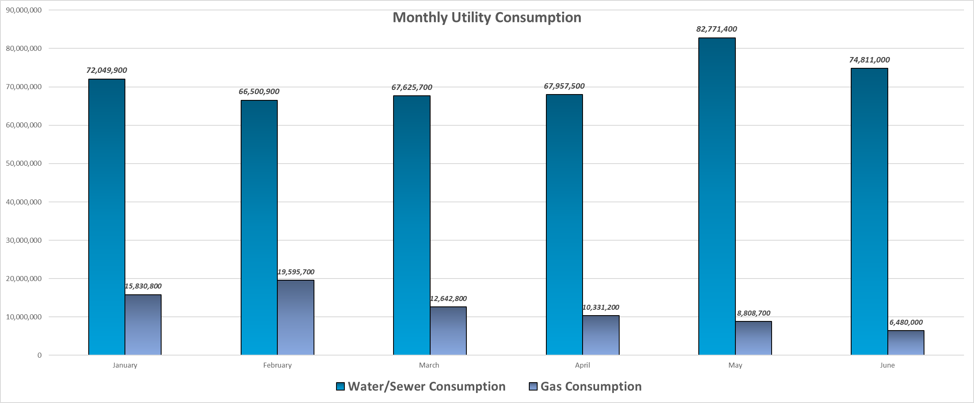

Slide 18
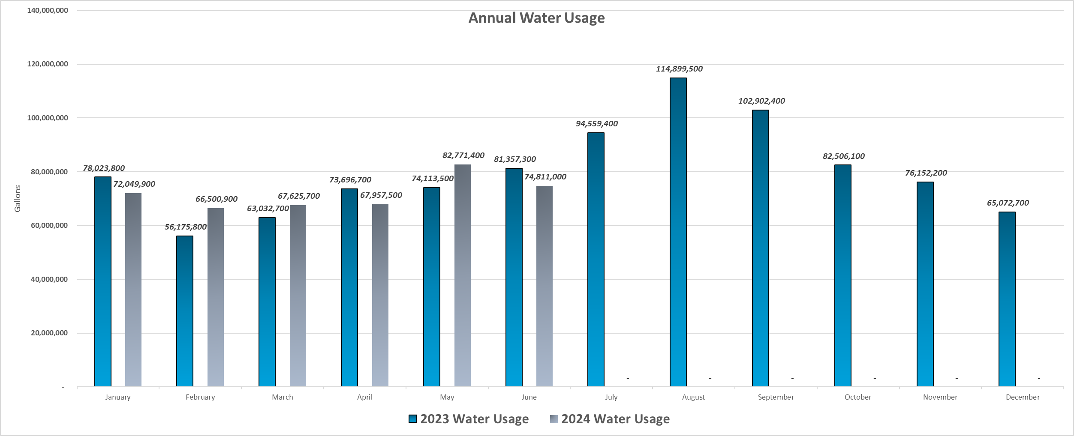

Slide 19

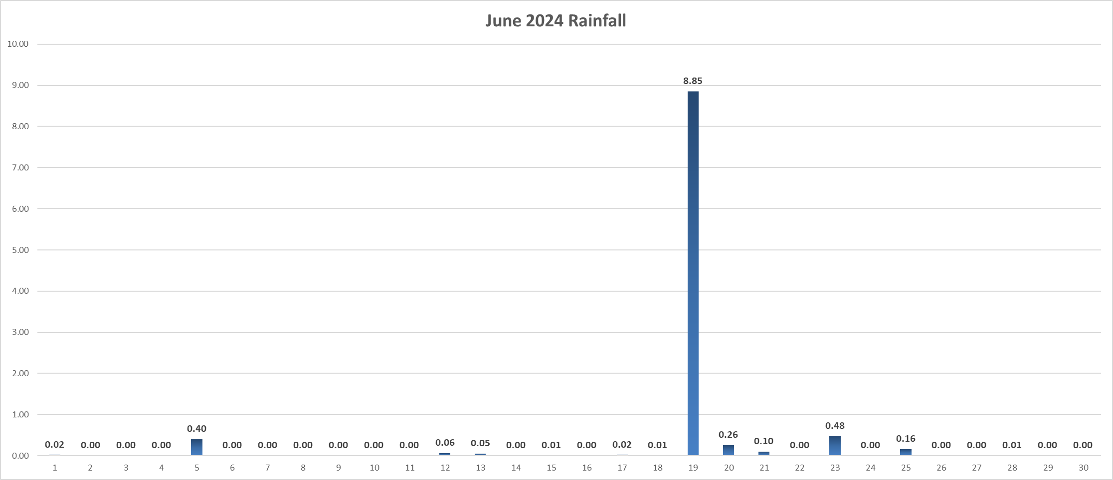

Slide 20
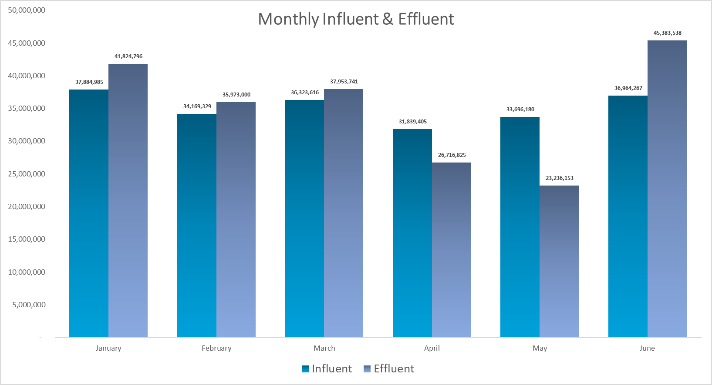
Influent: Wastewater or other liquid flowing into a reservoir, basin, or treatment plant.
Effluent: Wastewater or other liquid, partially or completely treated, flowing from a reservoir, basin, treatment process, or treatment plant.

Slide 21
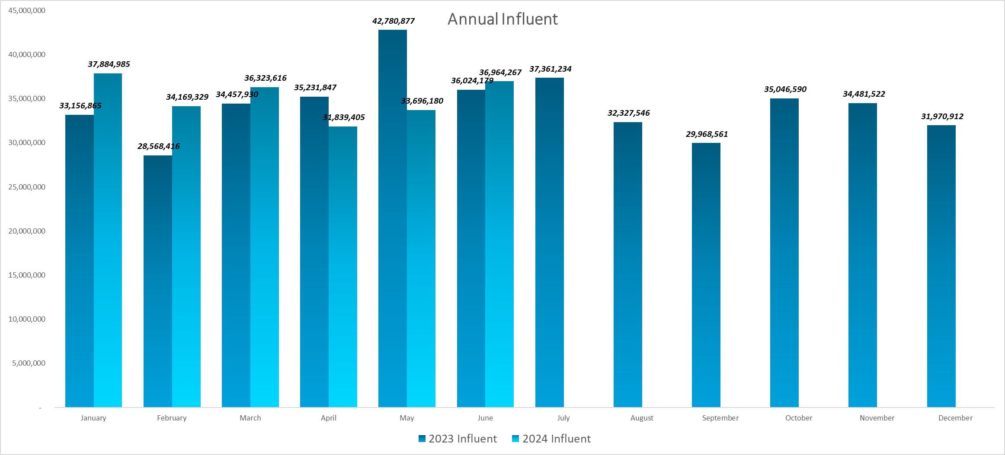

Slide 22
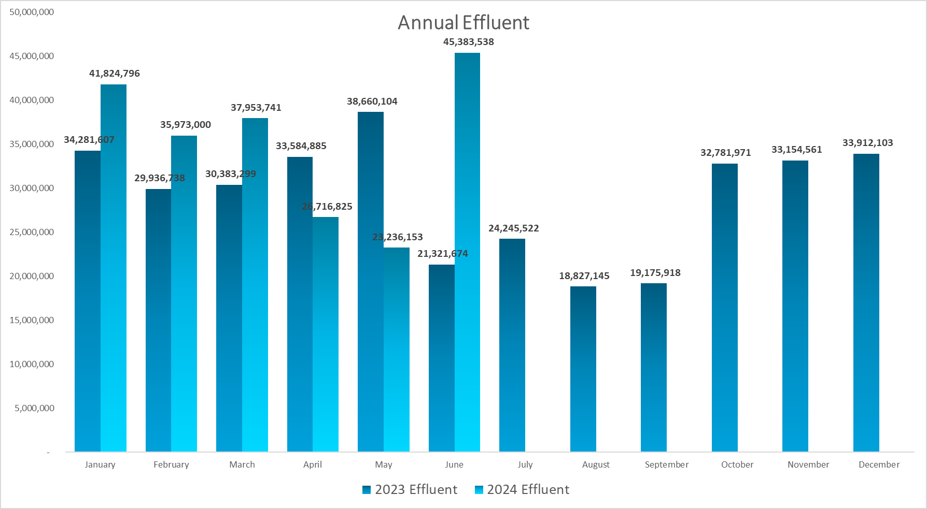

Slide 23
Human Resources
City Open Positions - June
  Recreation Program Assistant - Parks
  Assistant Director of Parks & Leisure Services
  Financial Management Analyst
  Municipal Court Clerk I (2)
  Natural Gas Maintenance Technician
New Hires/Positions Filled- June
  Municipal Court Clerk (1)
  Parks & Leisure Services Director
  Assistant Director of Parks & Leisure Services

Slide 24
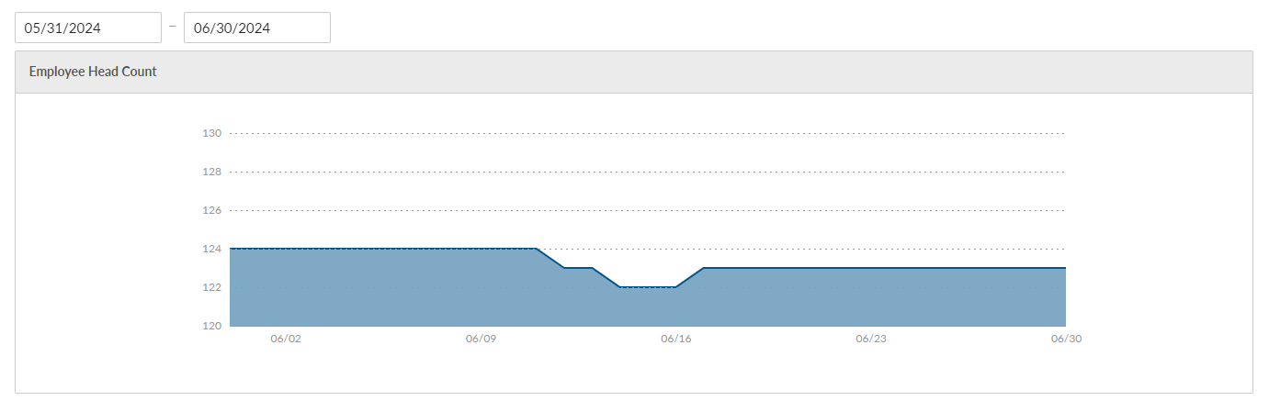
Human Resources
Additions & Separations
Separations - 1 New Hires -1 Internal Transfers - 2

Slide 25
Parks & Recreation Department
Pool Activities - June
  Group Swim Leesons Event Completed - 33 Participants
  Private Swim Lessons - 39 Conducted
  Pool Parties & Table Rentals - 12 Rentals
  Water Safety Instructor (WSI) Class Conducted - 5 Guards Certified
Park Activities - June
  Little League hosted Junior Boys and Softball Division All Star Tournaments at Memorial Park
  Centex Elite Baseball Tournament held at Memorial Park
  Proclamation issued for July as Parks & Recreation month
  Enrolled 3 Parks Staff for Master Gardener Class

Slide 26
Upcoming City Projects
Rockport Citizen University
Neighborhood Town Hall Meetings
City Manager/Police Department Coffees
Review of all City Ordinances
Agenda Management/Live Streaming

Slide 27
Miscellaneous
City Council Special Meeting August 6, 2024, at 1:00 p.m.
City Council Meeting Regular Meeting - August 13, 2024, at 6:30 p.m. (Public Hearing Utility Rates, Fees, Fire Fund, and proposed tax rate)
City Council Meeting Regular Meeting - August 27, 2024, at 6:30 p.m. (1st reading on Tax Rate and Public Hearing on FY2025 Budget)

