Slide 1


2025-2026
Preliminary Budget Workshop
7.29.25
REVENUE
PROPERTY TAX
TRANSFERS - IN
SALES TAX

Slide 2
Preliminary Budget Workshop
2025-2026
City’s Mission Statement: Our mission is to build a thriving community with a focus on growth, health, safety, and fiscal responsibility. We are committed to effective leadership and creating a vibrant sustainable City that preserves the charm of the Texas Coast, while ensuring a high quality of life, now and for generations to come.
City of Rockport was chartered by the Texas Legislature: August 18, 1870

Slide 3
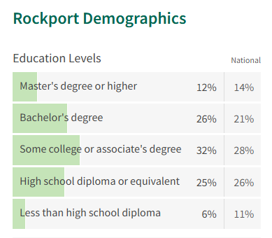
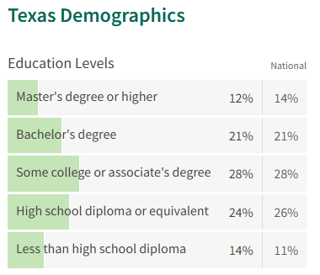
Preliminary Budget Workshop
2025-2026
Using National and State percentages as a benchmarks, the Rockport population is fairly well-educated – probably in large part due to age as seen on next slide.

Slide 4
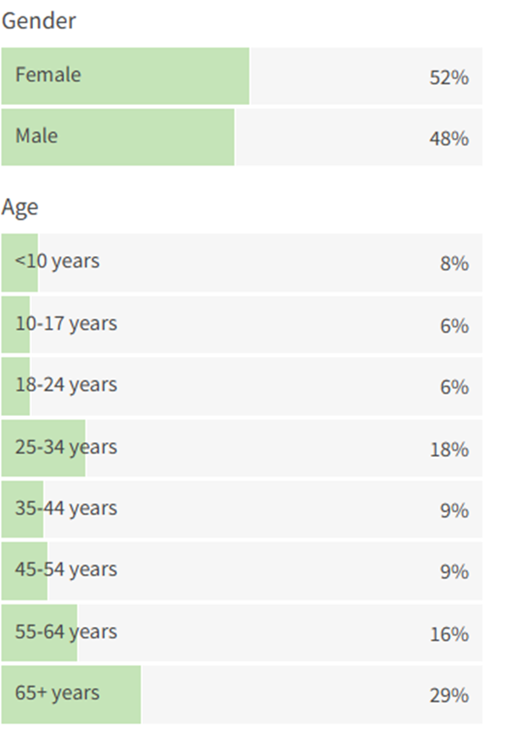
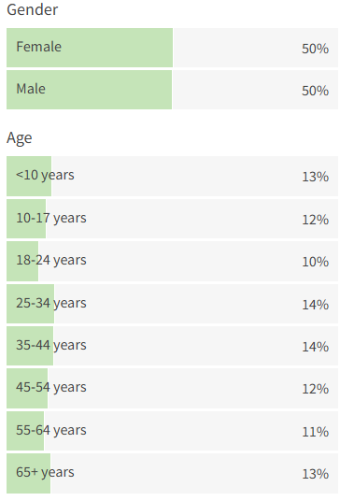
Preliminary Budget Workshop
2025-2026
Rockport Demographics
Texas Demographics
Over 50% of the population is over 50 and the median age is 50.3.

Slide 5
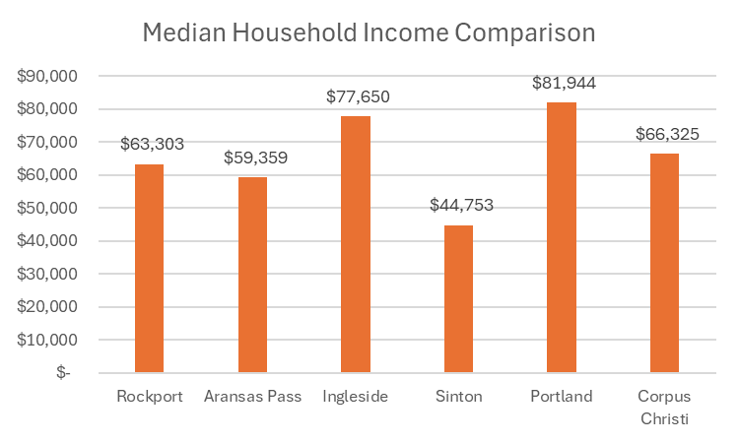
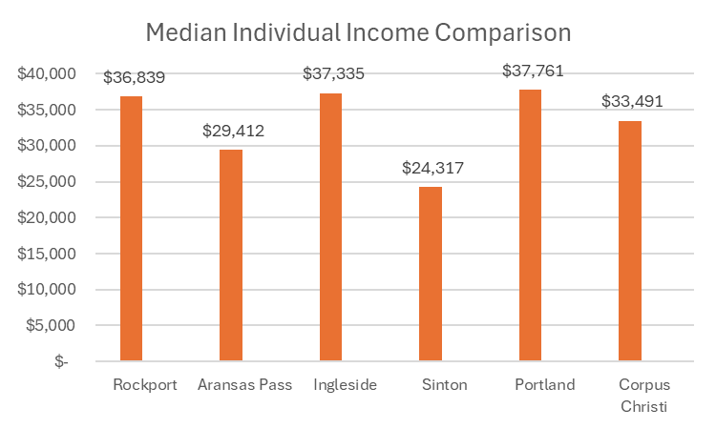
Preliminary Budget Workshop
2025-2026
National Median Household Income $78,538 – the City of Portland is the only City to exceed the national median.
National Median Household Income $39,982 – no cities exceed the national median. Rockport appears to rank better with individual vs. household median income.

Slide 6
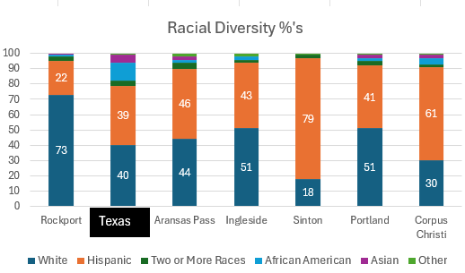
Preliminary Budget Workshop
2025-2026

Slide 7
Preliminary Budget Workshop
2025-2026

Slide 8
Preliminary Budget Workshop
2025-2026
*Budget Events/Discussions/Updates
*Last Workshop on 7/10 Council asked to include all Street work in CIP except for construction cost of Austin Street
*Budget includes Proposal A of Condrey Study and adds an estimated 23 days of General Fund Reserves

Slide 9
Preliminary
2025-2026 Budget
Project and Capital Request (pulled from 5-year CIP prioritization discussions on 5/29/25):
*Austin Street (Engineering & Design) $300,000
*Enterprise Drainage $200,000
*Bayshores & Broadway Street Erosion $400,000
*Enterprise Street Improvements $450,000
*Water Street Improvements $625,000
*Magnolia Street Improvements $300,000
*Market Street Improvements $300,000

Slide 10
Preliminary
2025-2026 Budget
(continued):
*Drainage RCC Holes #13 & #14 $800,000
*Cost of Issuance $100,000
*Upgrade of Substandard Roads: Palo Blanco & Balderree Lane $120,000
Total Streets, Drainage & Issuance $3,695,000

Slide 11
Preliminary
2025-2026 Budget
Project and Capital Request (pulled from 5-year CIP prioritization discussions at 5/29/25 Budget Workshop):
*Reimbursement Resolution for Rockport Volunteer Fire Department $667,459
*Vehicle & Equipment Replacement $752,000
*Police Radios $470,000
*Fleet Equipment Storage Shelter $100,000
*Belt Press $500,000
*Insert Valve Machine $134,016

Slide 12
Preliminary
2025-2026 Budget
Continued from previous page:
*Evidence Vehicle for CID $65,000
*Purple Pipe to Memorial Park $500,000
*Cost of Issuance $75,000
Total $3,263,475
Total CIP for 2025-2026 $6,958,475

Slide 13
Preliminary Budget w/Plan A compensation plan and 30 days reserves per Strategic Plan.
Includes Street CIP, cover V&E and other top department/Council priorities

Slide 14
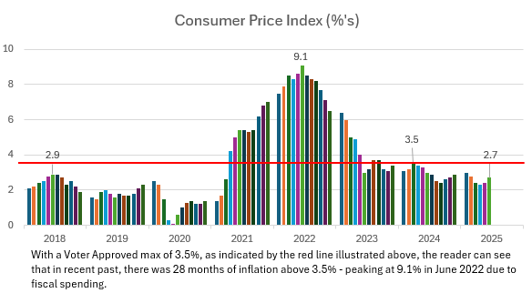
The above red line running through the Bureau of Labor Statistics Consumer Price Index represents a 3.5% level of inflation. While inflation has come down from a high of 9.1% in June of 2022 to 2.7% in June of 2025.

Slide 15
Status of Presentation
2025-2026 Preliminary Budget
Presentation utilizes Certified Appraisal Tax Roll data for 2025
Freeze Adjusted Taxable Certified Appraisal Rolls were $45M less than Preliminary Appraisal Rolls due mostly to Hotel/Motel protests
Next slide reflects 2025 Certified values from the Chief Appraiser and estimated tax rate calculations
these numbers will change
The Tax Assessor Collector Calculates Tax Final Tax Rates and collections rate

Slide 16
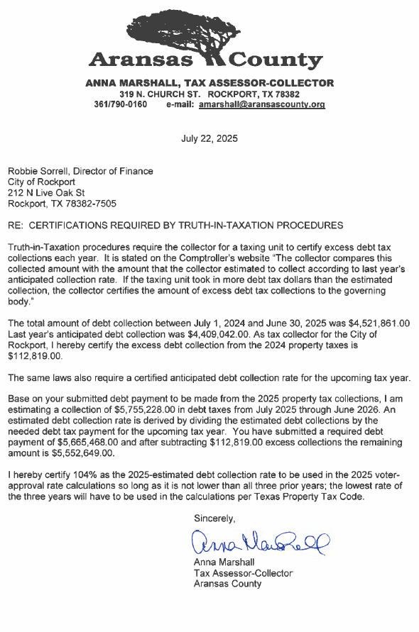
Due to excess collections this year, debt requirements were reduced $113k to $5.5M.
Tax-Assessor will use 104% as collections rate for Voter Approved Rate

Slide 17
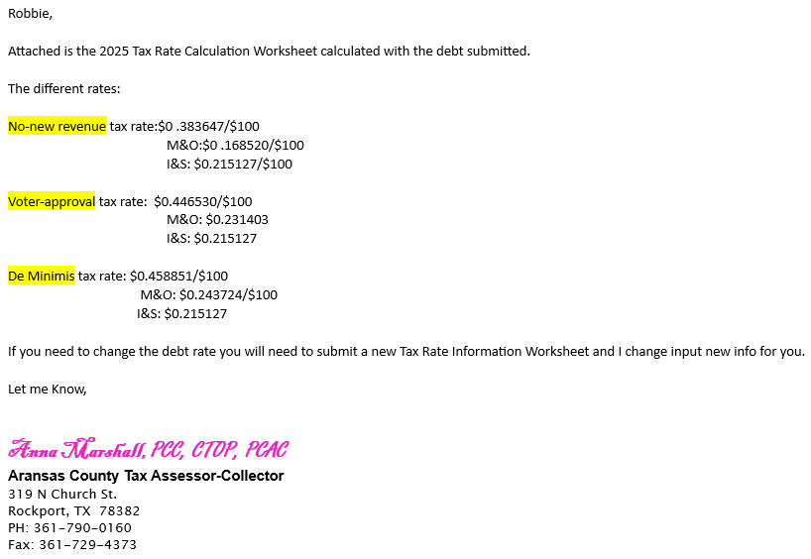
Preliminary
2025-2026 Budget

Slide 18
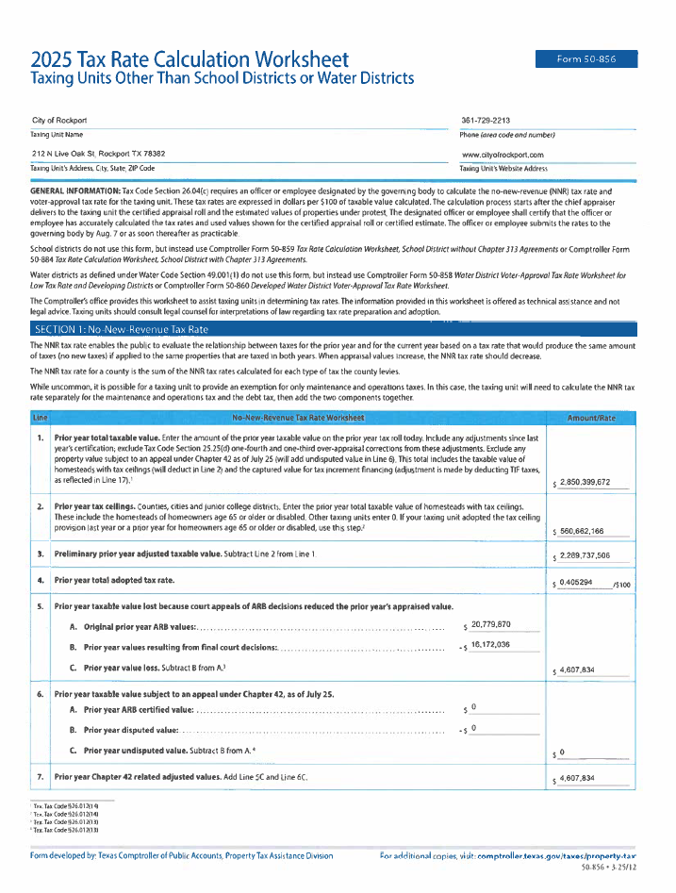

Slide 19
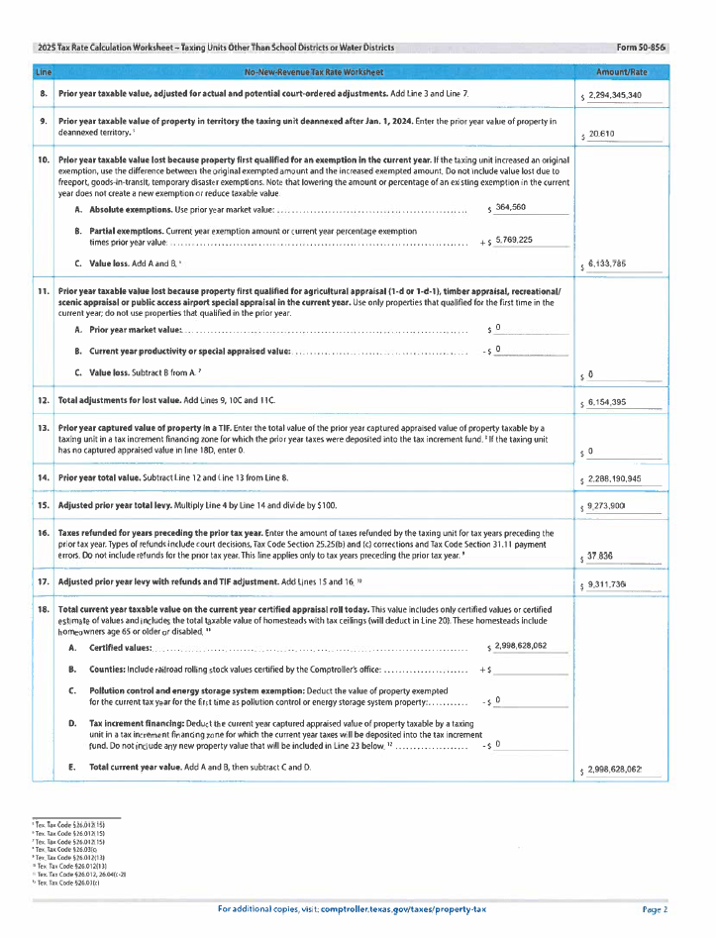

Slide 20
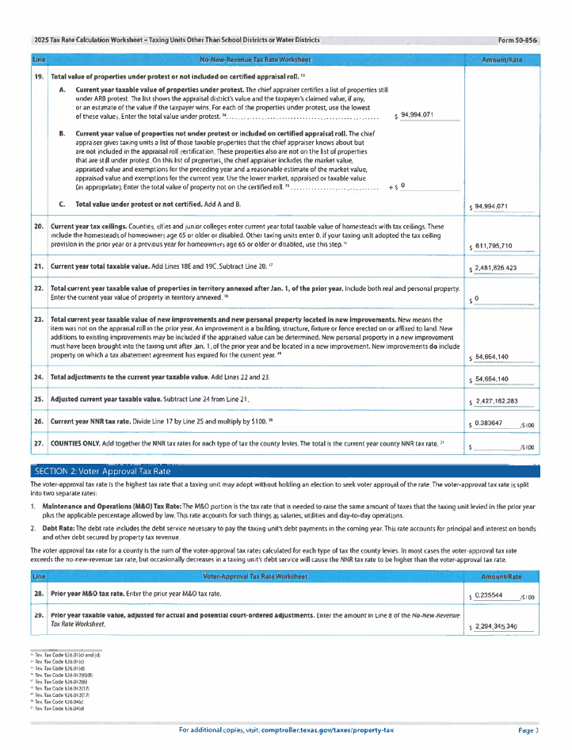

Slide 21
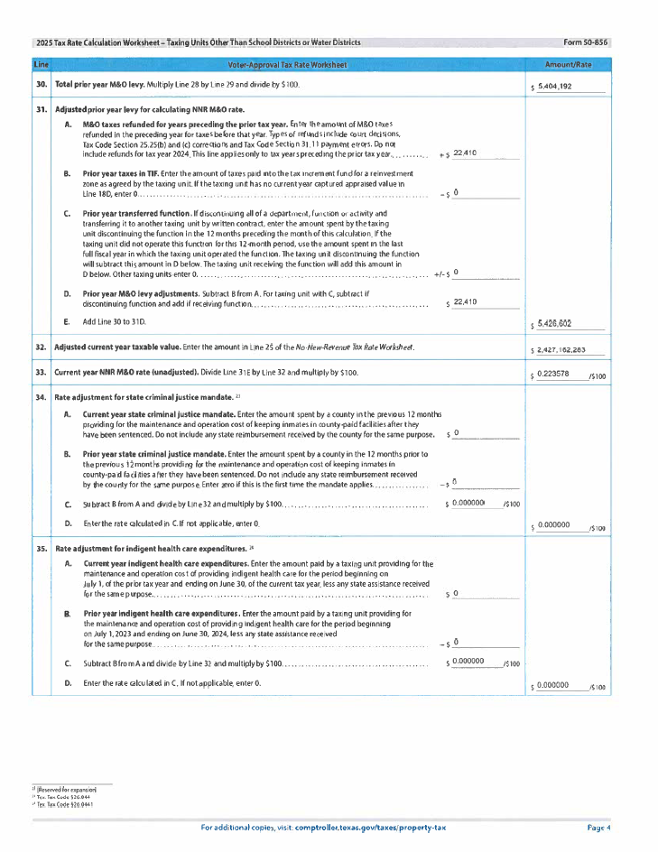

Slide 22
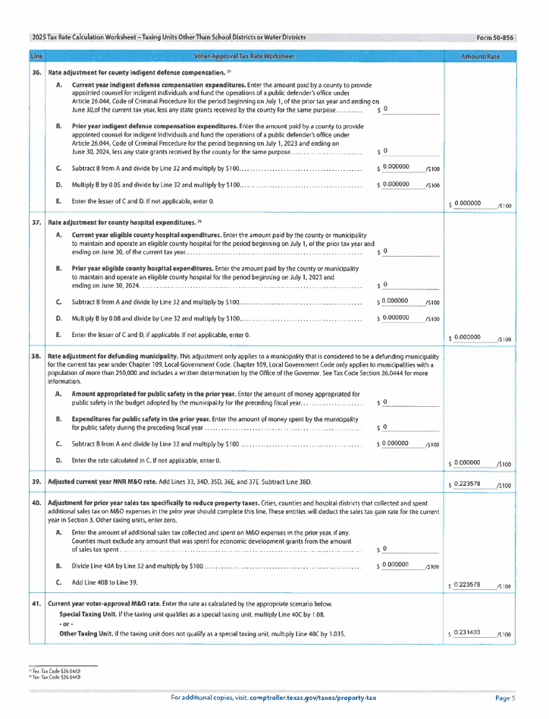

Slide 23
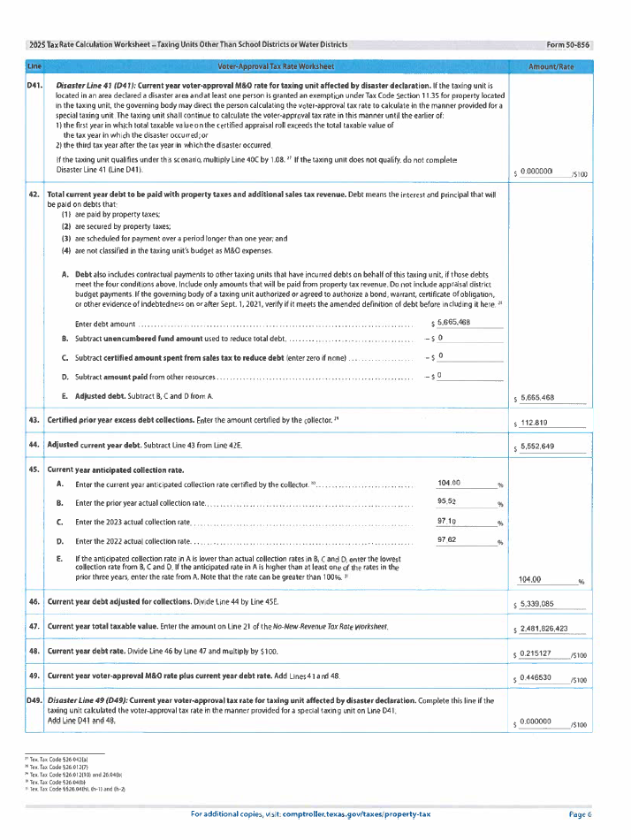

Slide 24
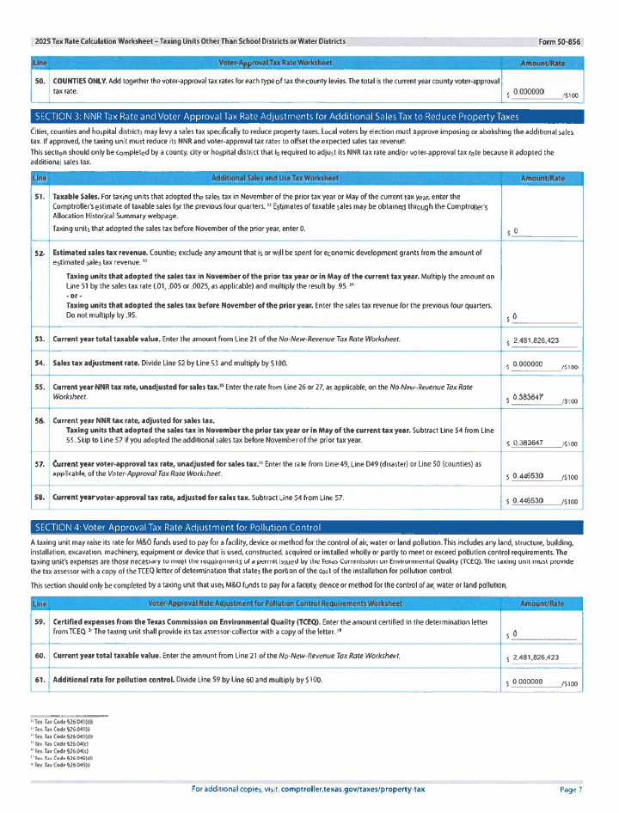

Slide 25
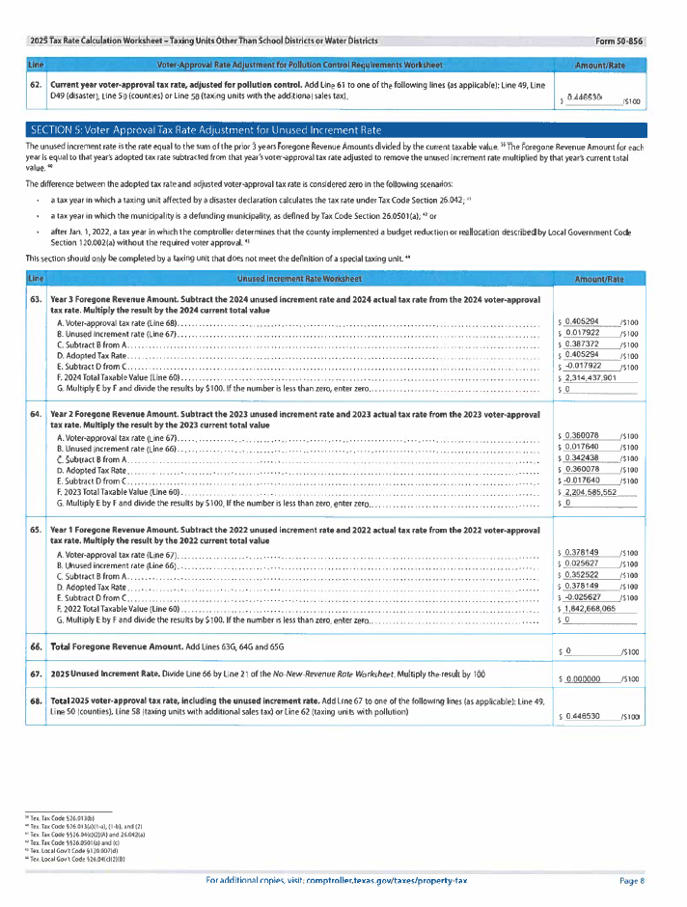

Slide 26
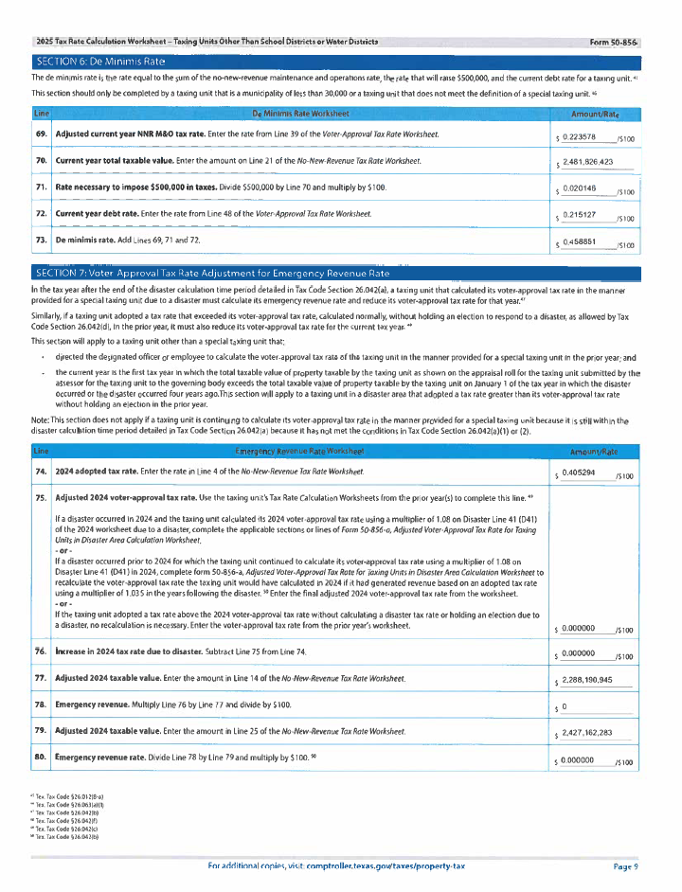

Slide 27
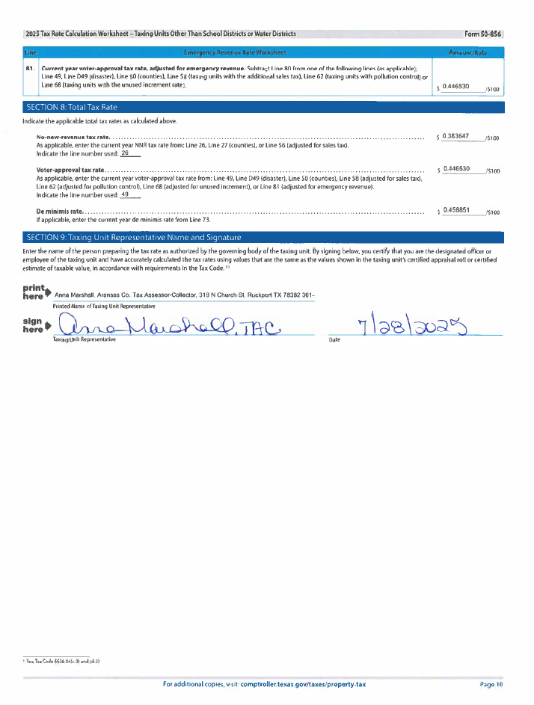

Slide 29
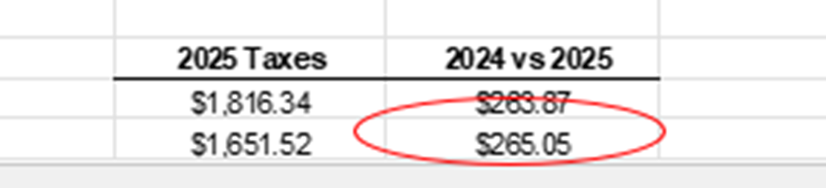
Preliminary
2025-2026 Budget

Slide 30
Preliminary
2025-2026 Budget
Overall revenue increase of $57k (M&O), and $1,356 (I&S)
About 13.2% more revenue than last year
Collection percentage assumption 104%
So marginally speaking the preliminary marginal tax increase of $265.05 divided by marginal tax value increase on average home of $27,767:
$265.05/$27,767 = .01 or 1.0%

Slide 31
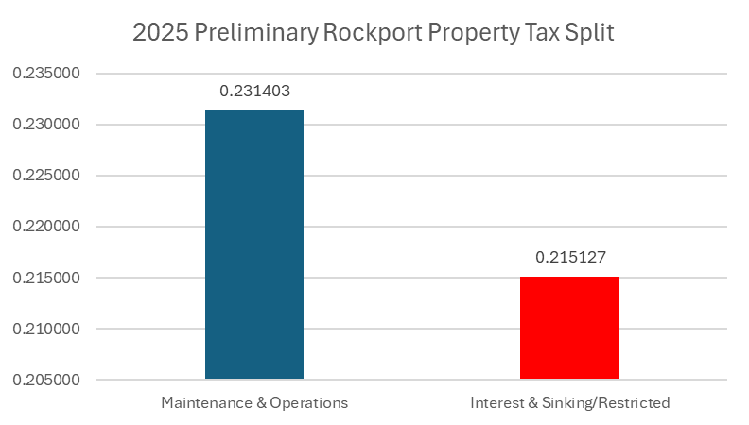
Preliminary
2025-2026 Budget
General Fund Property Taxes @ $.446530/$100 (52%/48% split)
- Maintenance & Operations (capped at 3.5% increase per year)
- Interest & Sinking side (not capped but restricted)

Slide 32
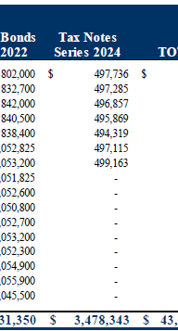
Preliminary
2025-2026 Budget
*Annual Amortization is approximately $500k per year as per 2024 Tax Notes snippet.
*City issued $3,075,000 in tax notes in 2024
*Tax Note was 3.74%

Slide 33
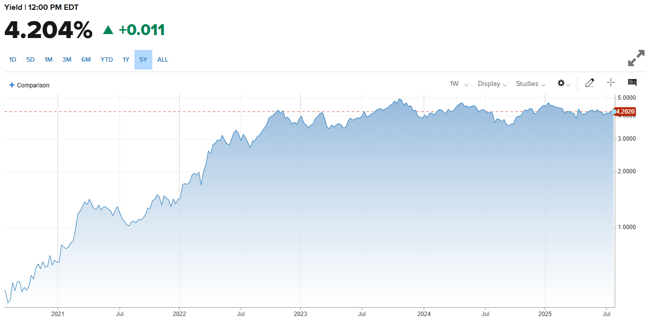
Preliminary
2025-2026 Budget
7-Year Treasury Yield History

Slide 34
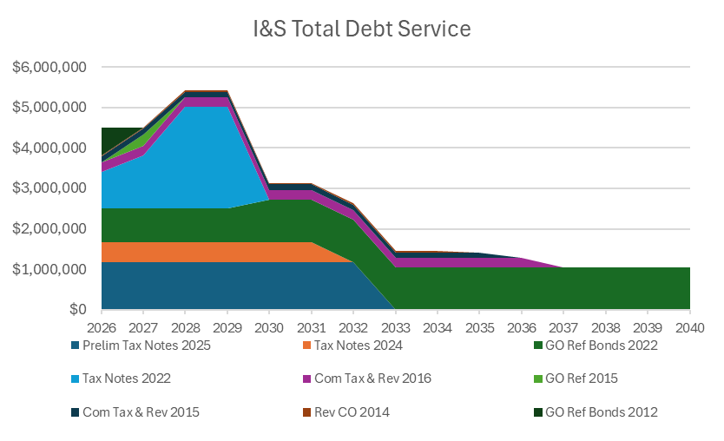
Preliminary
2025-2026 Budget

Slide 35
Preliminary
2025-2026 Budget
Estimated $7M in Tax Notes

Slide 36
Preliminary
2025-2026 Budget

Slide 37
Preliminary
2025-2026 Budget

Slide 38
Preliminary
2025-2026 Budget

Slide 39
Preliminary
2025-2026 Budget

Slide 40
Preliminary
2025-2026 Budget

Slide 41
Preliminary
2025-2026 Budget

Slide 42
Preliminary
2025-2026 Budget

Slide 43
Preliminary
2025-2026 Budget

Slide 44
Preliminary
2025-2026 Budget

Slide 45
Preliminary
2025-2026 Budget

Slide 46
Preliminary
2025-2026 Budget

Slide 47
Preliminary
2025-2026 Budget

Slide 48
Preliminary
2025-2026 Budget

Slide 49
Preliminary
2025-2026 Budget

Slide 50
Preliminary
2025-2026 Budget

Slide 51
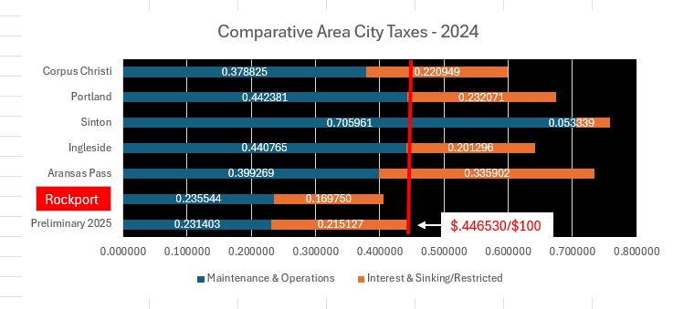
Preliminary
2025-2026 Budget

Slide 52
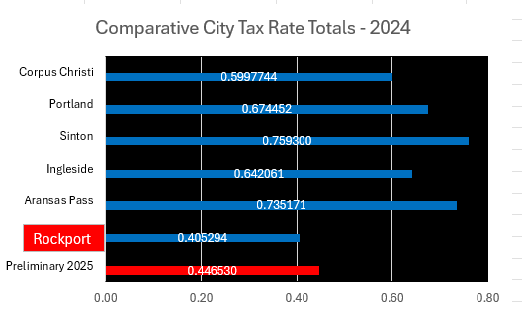
Preliminary
2025-2026 Budget

Slide 53
Financial Priorities 2025-2026
Need 2024 Audit beginning Fund Balances
Reserves are recommended to be 180 days of expenditures, at the end of FY 2023, the City had 111 days. The number of reserve days at the end of FY 2024 is still to be determined

Slide 54
Budget Priorities 2025-2026
*Departments scrubbed their budgets achieving base budget YoY declines of almost 2% for General Fund and Utility Fund
*Preliminary Budget includes Voter Approved Rate (3.5% max)
*Budget excludes Gas System
*Includes funded Marketing Position for Hotel/Motel
*Includes Plan A of Compensation Plan (Approx $1,020k) and almost 23 days of General Fund Reserves ($16,111,843/365=$44,142 X 30 days = $1,324,261)
*Includes debt service increase to cover over $7M in CIP/V&E/Reimb. Resolution
*Wildan Study for year two for Water/Wastewater
*Sanitation includes 4% increase to cover inflation
*Added Insurance Budget to protect new City Hall

Slide 55
Budget Calendar

Slide 56
Work as a Team
Questions?
City?
Department?

Slide 57
Five-Year Capital Improvement Projects

Slide 58
Five Year Capital Improvement Projects

Slide 59
Five Year Capital Improvement Projects

Slide 60
Five Year Capital Improvement Projects

Slide 61
Five Year Capital Improvement Projects

Slide 62
Five Year Capital Improvement Projects

Slide 63
Five Year Capital Improvement Projects

