Slide 1


2025-2026 Preliminary Budget Workshop 8.5.25
REVENUE
PROPERTY TAX
TRANSFERS - IN
SALES TAX

Slide 2
Preliminary Budget Workshop 2025-2026
City’s Mission Statement: Our mission is to build a thriving community with a focus on growth, health, safety, and fiscal responsibility. We are committed to effective leadership and creating a vibrant sustainable City that preserves the charm of the Texas Coast, while ensuring a high quality of life, now and for generations to come.
City of Rockport was chartered by the Texas Legislature: August 18, 1870

Slide 3
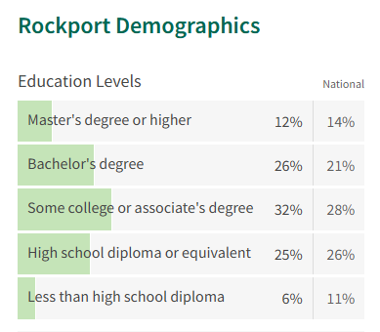
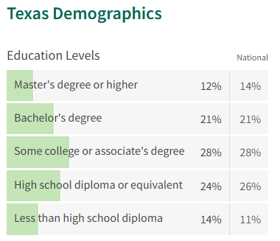
Preliminary Budget Workshop 2025-2026
Using National and State percentages as a benchmarks, the Rockport population is fairly well-educated – probably in large part due to age as seen on next slide.

Slide 4
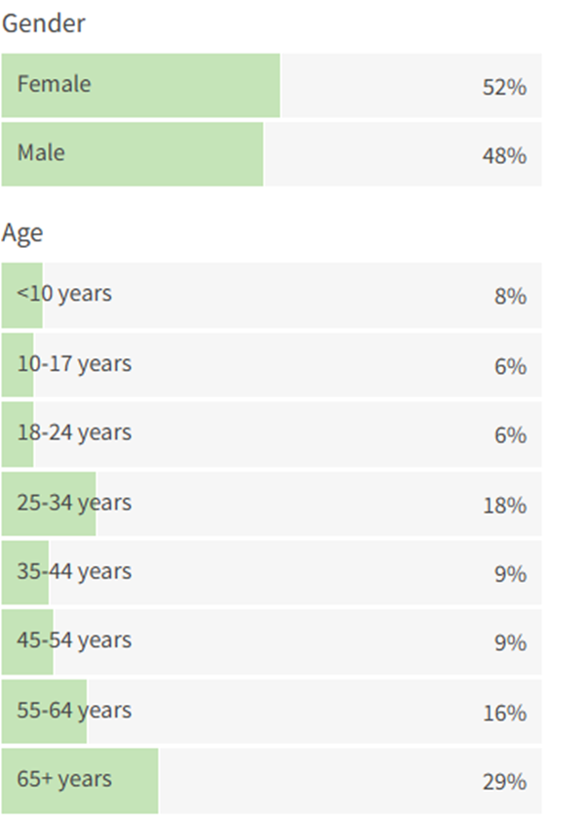
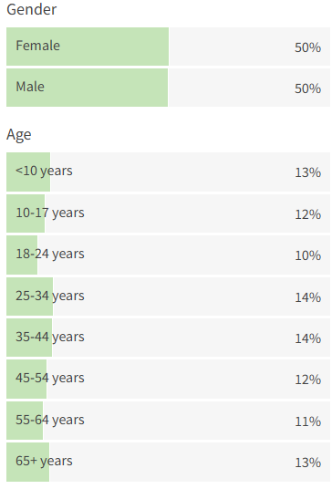
Preliminary Budget Workshop 2025-2026
Rockport Demographics
Texas Demographics
Over 50% of the population is over 50 and the median age is 50.3.

Slide 5
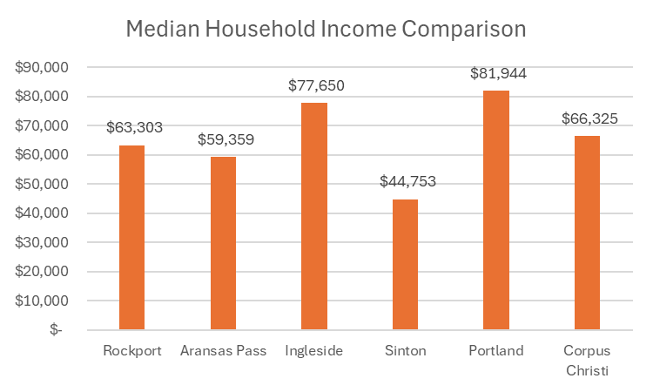
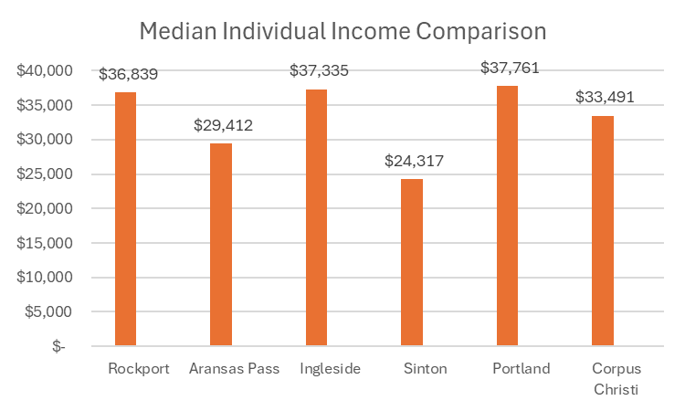
Preliminary Budget Workshop 2025-2026
National Median Household Income $78,538 – the City of Portland is the only City to exceed the national median.
National Median Household Income $39,982 – no cities exceed the national median. Rockport appears to rank better with individual vs. household median income.

Slide 6
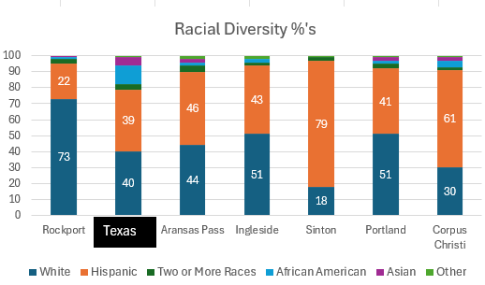
Preliminary Budget Workshop 2025-2026

Slide 7
Preliminary Budget Workshop 2025-2026

Slide 8
Preliminary Budget Workshop 2025-2026
*Budget Events/Discussions/Updates
*Last Workshop on 7/10 Council asked to include all Street work in CIP except for construction cost of Austin Street
*Budget includes Proposal A of Condrey Study and adds an estimated 23 days of General Fund Reserves
*Budget includes incentives for employees to be on alternative insurance options (spouse/military/etc.)
*Budget includes HOT at $1,345,250 per 7/29 meeting
*Average Taxable/Market Home Values Updated on property tax slide

Slide 9
Preliminary 2025-2026 Budget
Project and Capital Request (pulled from 5-year CIP prioritization discussions on 5/29/25):
*Austin Street (Engineering & Design) $300,000
*Enterprise Drainage $200,000
*Bayshores & Broadway Street Erosion $400,000
*Enterprise Street Improvements $450,000
*Water Street Improvements $625,000
*Magnolia Street Improvements $300,000
*Market Street Improvements $300,000

Slide 10
Preliminary 2025-2026 Budget
(continued):
*Drainage RCC Holes #13 & #14 $800,000
*Cost of Issuance $100,000
*Upgrade of Substandard Roads: Palo Blanco & Balderree Lane $120,000
Total Streets, Drainage & Issuance $3,695,000

Slide 11
Preliminary 2025-2026 Budget
Project and Capital Request (pulled from 5-year CIP prioritization discussions at 5/29/25 Budget Workshop):
*Reimbursement Resolution for Rockport Volunteer Fire Department $667,459
*Vehicle & Equipment Replacement $752,000
*Police Radios $470,000
*Fleet Equipment Storage Shelter $100,000
*Belt Press $500,000
*Insert Valve Machine $134,016

Slide 12
Preliminary 2025-2026 Budget
Continued from previous page:
*Evidence Vehicle for CID $65,000
*Purple Pipe to Memorial Park $500,000
*Cost of Issuance $75,000
Total $3,263,475
Total CIP for 2025-2026 $6,958,475

Slide 13
Preliminary Budget w/Plan A compensation plan and 23 days reserves per Strategic Plan. Includes Street CIP, cover V&E and other top department/Council priorities

Slide 14
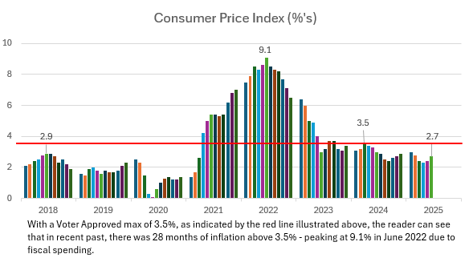
The above red line running through the Bureau of Labor Statistics Consumer Price Index represents a 3.5% level of inflation. While inflation has come down from a high of 9.1% in June of 2022 to 2.7% in June of 2025.

Slide 15
Status of Presentation 2025-2026 Preliminary Budget
Presentation utilizes Certified Appraisal Tax Roll data for 2025
Freeze Adjusted Taxable Certified Appraisal Rolls were $40M less than Preliminary Appraisal Rolls due mostly to Hotel/Motel protests
Next slide reflects 2025 Certified values from the Chief Appraiser and estimated tax rate calculations
these numbers will change
The Tax Assessor Collector Calculates Tax Final Tax Rates and collections rate

Slide 16
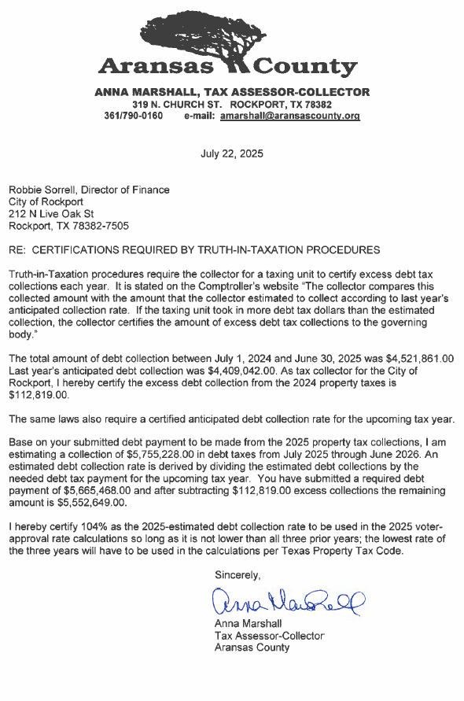
Due to excess collections this year, debt requirements were reduced $113k to $5.5M.
Tax-Assessor will use 104% as collections rate for Voter Approved Rate

Slide 17
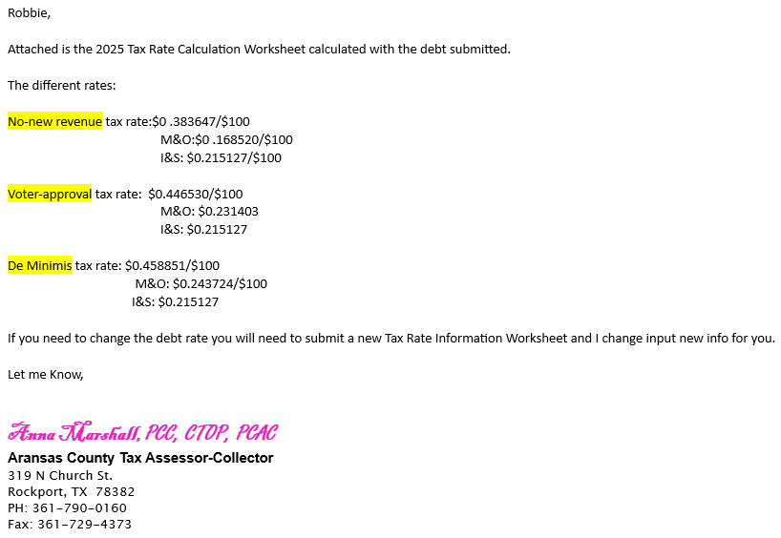
Preliminary 2025-2026 Budget

Slide 18
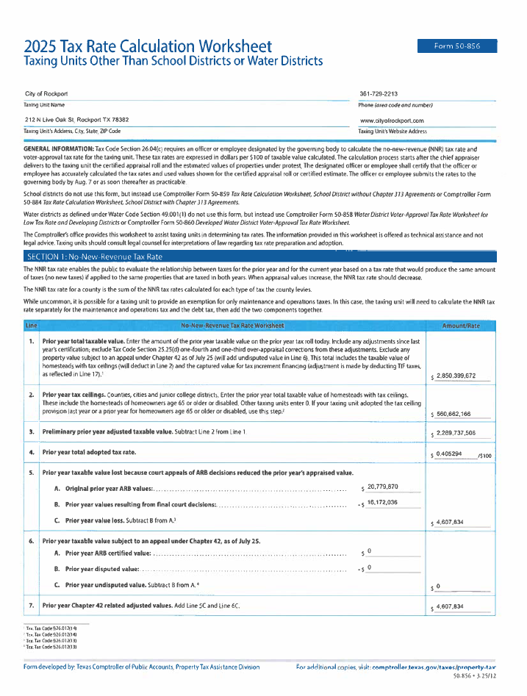

Slide 19
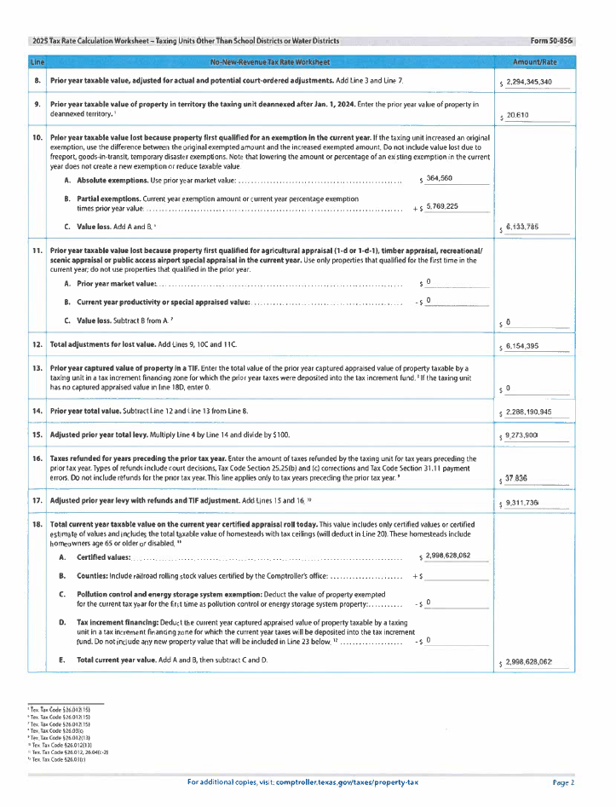

Slide 20
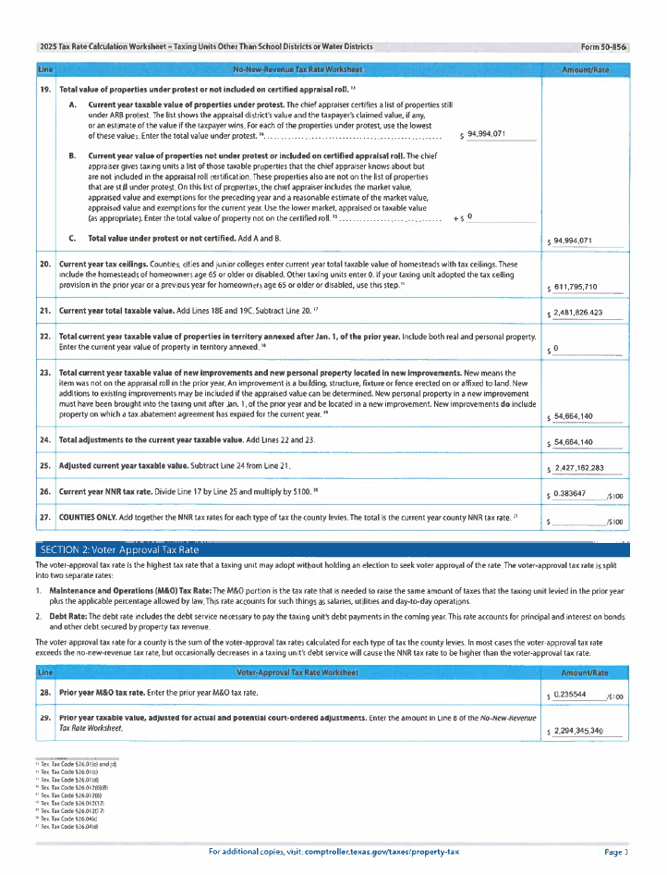

Slide 21
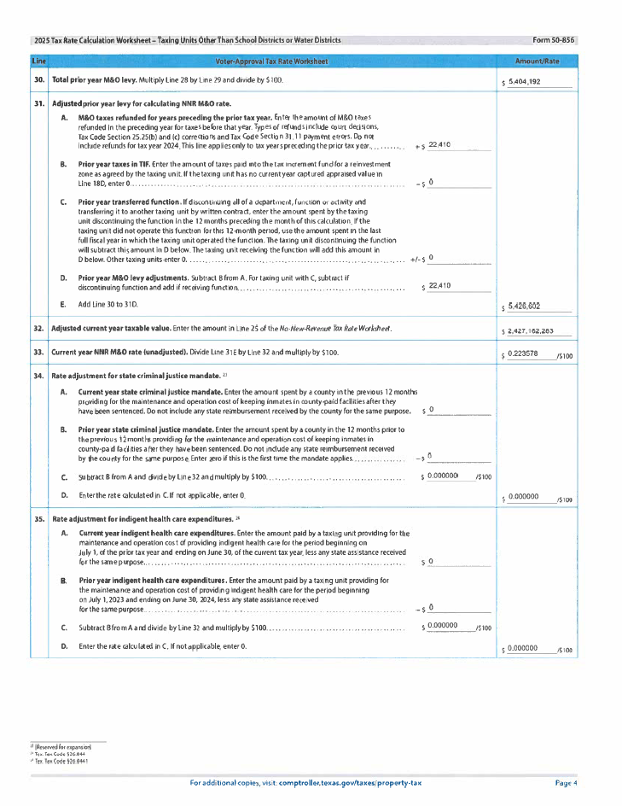

Slide 22
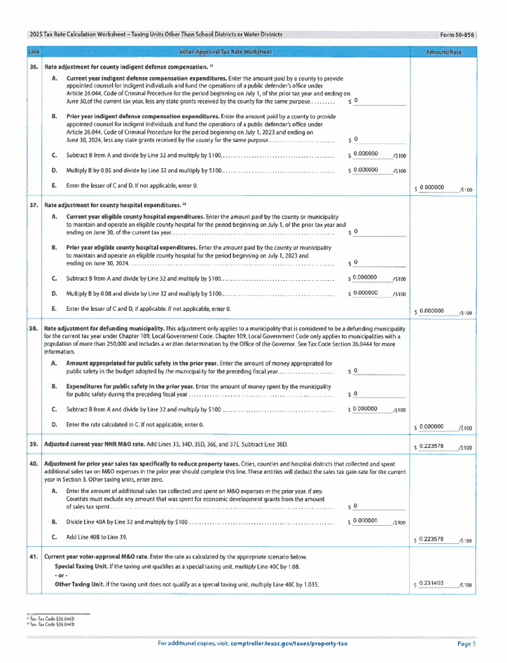

Slide 23
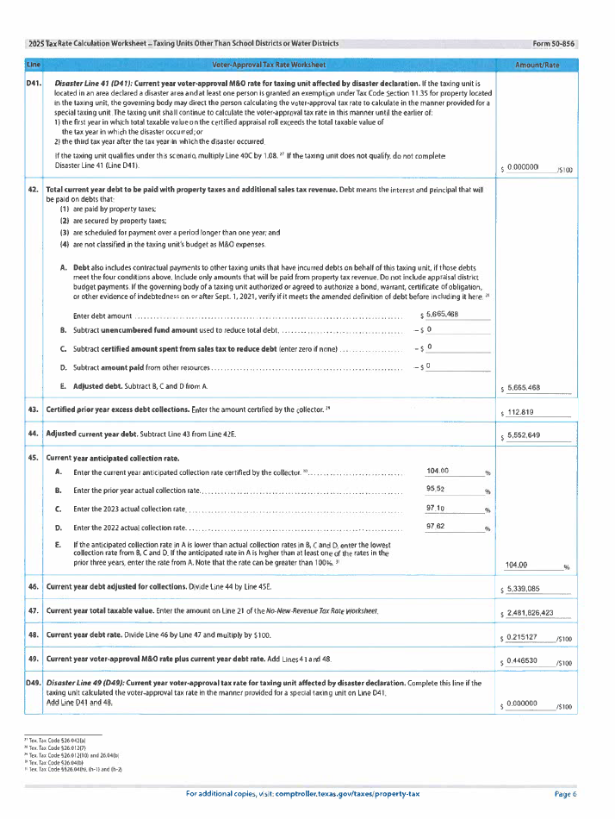

Slide 24
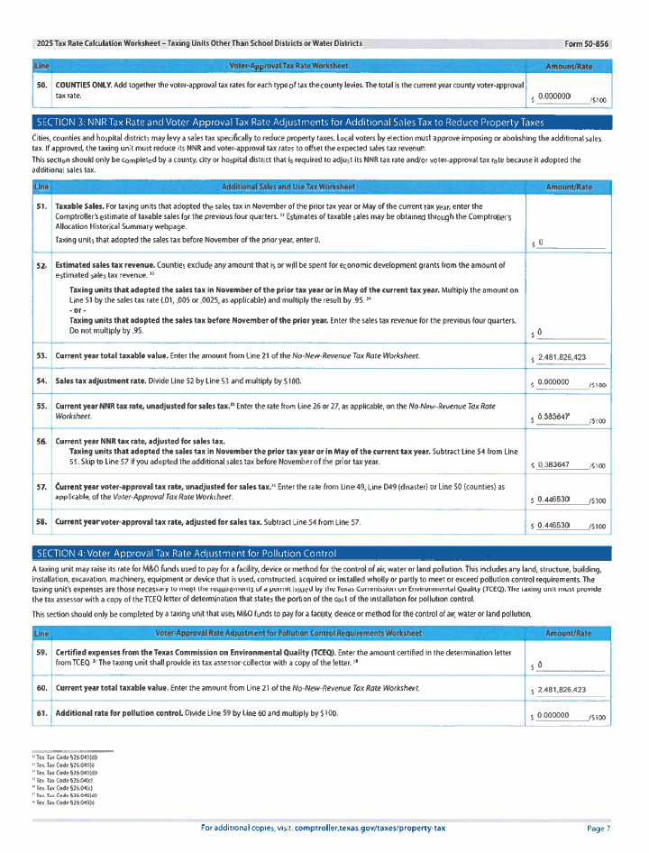

Slide 25
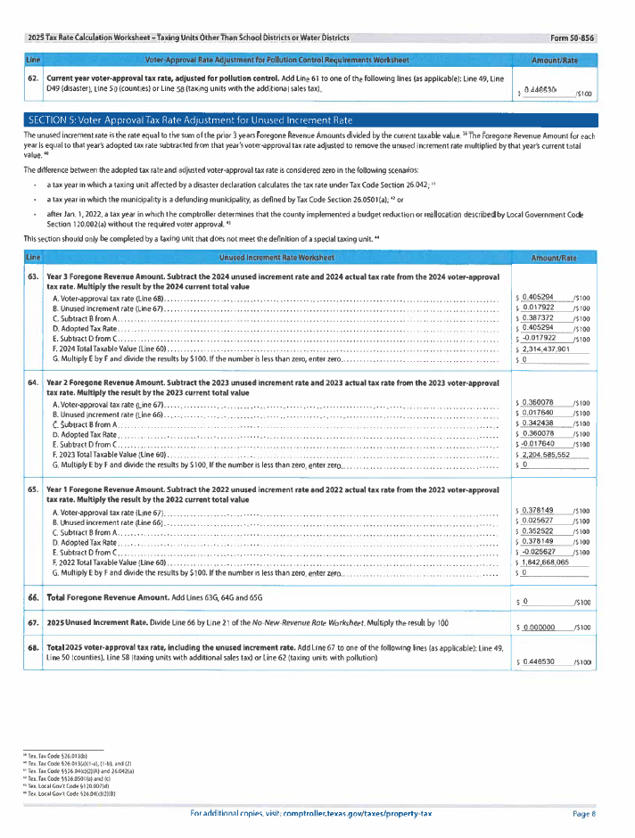

Slide 26
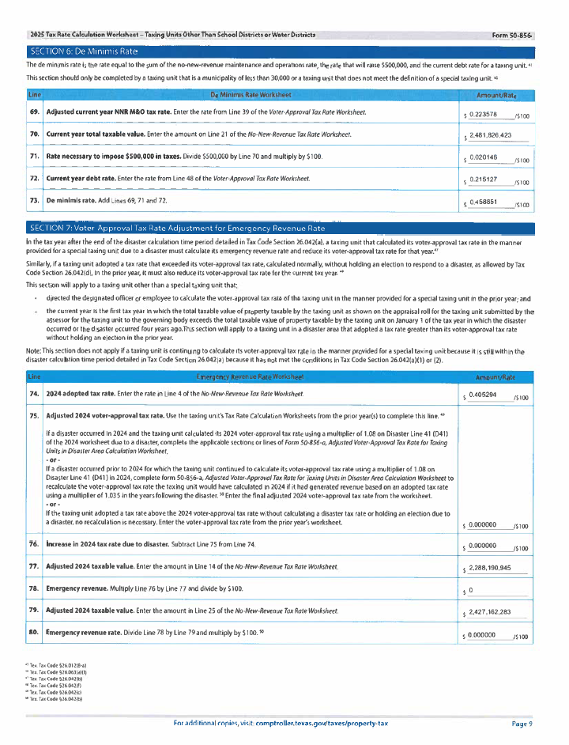

Slide 27
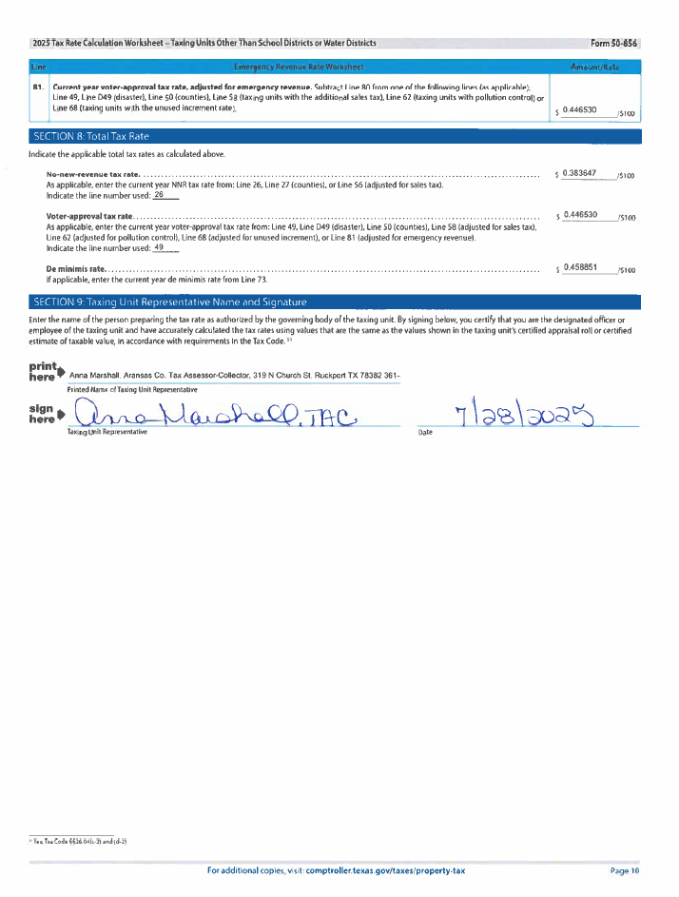

Slide 29
Preliminary 2025-2026 Budget
Overall revenue increase of $221k (M&O), and $1,356 (I&S)
About 13.2% more revenue than last year
Collection percentage assumption 104% (96% equivalent per on our Excel worksheet) on I&S and 98.5% on M&O
So marginally speaking the preliminary marginal tax increase of $252.37 divided by marginal tax value increase on average home of $24,926:
$252.37/$24,926 = .01 or 1.0%

Slide 30
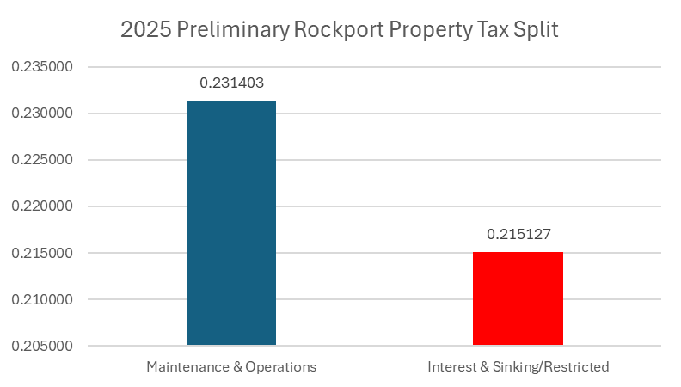
Preliminary 2025-2026 Budget
General Fund Property Taxes @ $.446530/$100 (52%/48% split)
- Maintenance & Operations (capped at 3.5% increase per year)
- Interest & Sinking side (not capped but restricted)

Slide 31
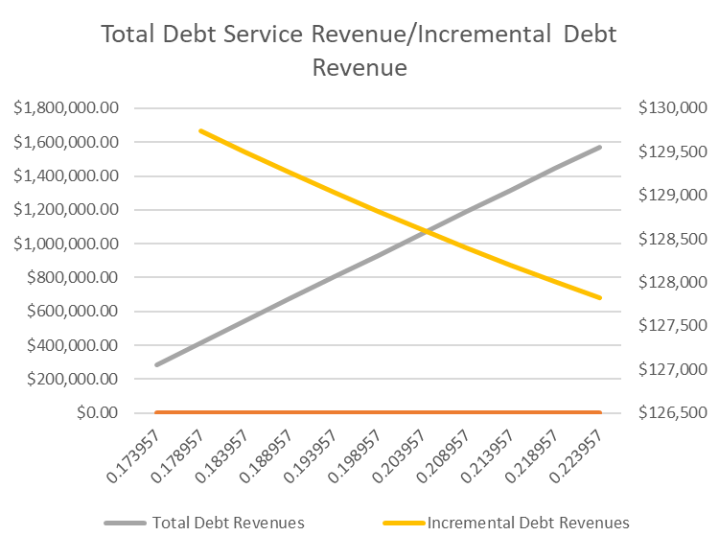
Preliminary 2025-2026 Budget
The graph above shows that the debt rate and amount of debt revenue received for each incremental cent is not linear. The higher the debt rate the less the marginal revenue is received for each increment.

Slide 32
Preliminary 2025-2026 Budget
Here is the raw data supporting the previous graph. We can see that for each half cent increase or decrease there is about a $200 change in debt revenues to service the debt.

Slide 33
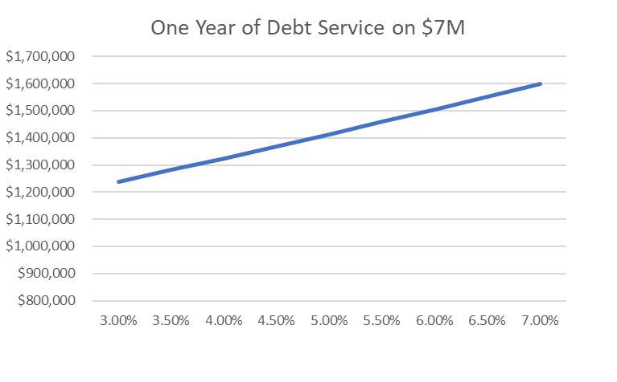
Preliminary 2025-2026 Budget
The above graph reflects the approximate cost of one-year of debt service on $7M in bonds issued at different interest rates.

Slide 34
Preliminary 2025-2026 Budget
The above raw data supports the graph on the previous slide. For every half point change in interest rates debt service changes of about $700 per year.

Slide 35
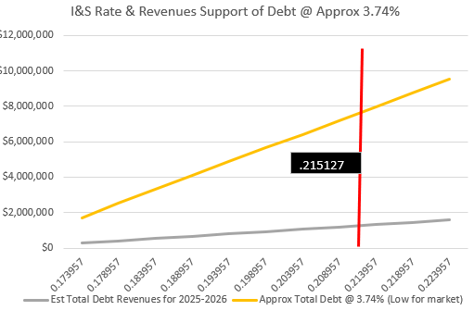
Preliminary 2025-2026 Budget
This graph reflects the debt revenues vs. debt service required over multiple I&S rates in the first year. The red line represents TAC calculations to support the debt need to fund Streets, Drainage, and V&E.

Slide 36
Preliminary 2025-2026 Budget
This is the raw data supporting the previous graph. It also includes the estimated level needed to support the V&E and Streets/Drainage. The levels are estimated one level higher as 3.74% was used which inflates Approx Debt.

Slide 37
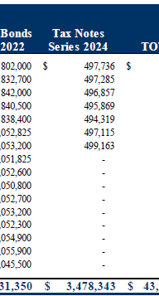
Preliminary 2025-2026 Budget
*Annual Amortization is approximately $500k per year as per 2024 Tax Notes snippet.
*City issued $3,075,000 in tax notes in 2024
*Tax Note was 3.74%

Slide 38
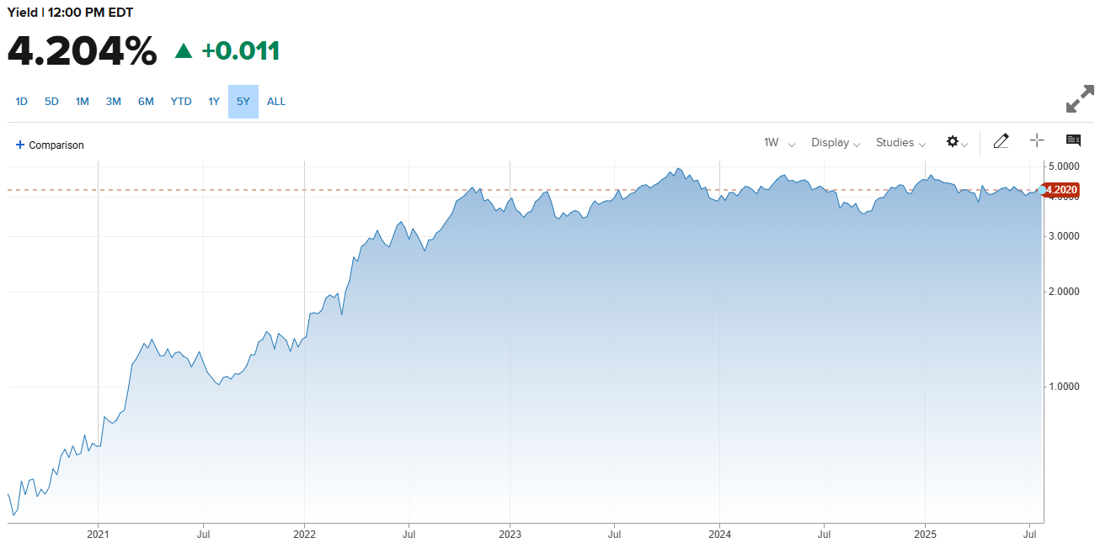
Preliminary 2025-2026 Budget
7-Year Treasury Yield History

Slide 39
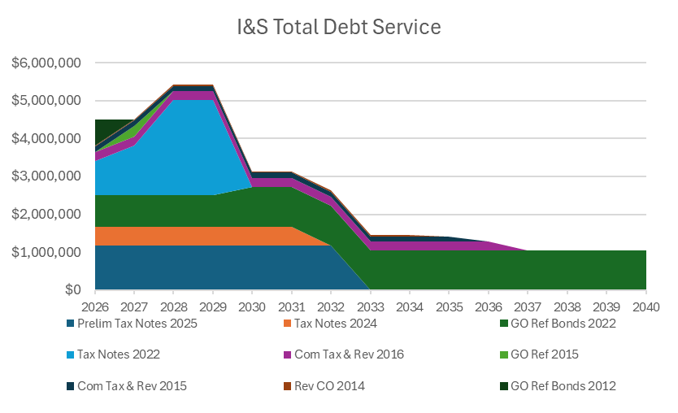
Preliminary 2025-2026 Budget

Slide 40
Preliminary 2025-2026 Budget
Estimated $7M in Tax Notes

Slide 41
Preliminary 2025-2026 Budget

Slide 42
Preliminary 2025-2026 Budget

Slide 43
Preliminary 2025-2026 Budget

Slide 44
Preliminary 2025-2026 Budget

Slide 45
Preliminary 2025-2026 Budget

Slide 46
Preliminary 2025-2026 Budget

Slide 47
Preliminary 2025-2026 Budget

Slide 48
Preliminary 2025-2026 Budget

Slide 49
Preliminary 2025-2026 Budget

Slide 50
Preliminary 2025-2026 Budget

Slide 51
Preliminary 2025-2026 Budget

Slide 52
Preliminary 2025-2026 Budget

Slide 53
Preliminary 2025-2026 Budget

Slide 54
Preliminary 2025-2026 Budget

Slide 55
Preliminary 2025-2026 Budget

Slide 56
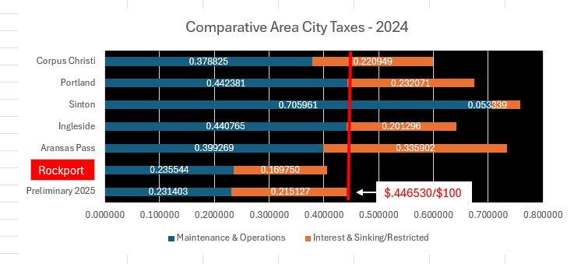
Preliminary 2025-2026 Budget

Slide 57
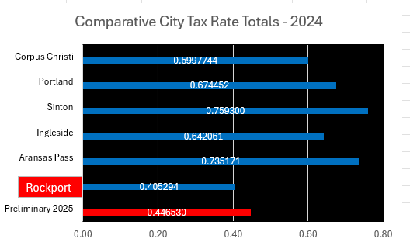
Preliminary 2025-2026 Budget

Slide 58
Financial Priorities 2025-2026
Need 2024 Audit beginning Fund Balances
Reserves are recommended to be 180 days of expenditures, at the end of FY 2023, the City had 111 days. The number of reserve days at the end of FY 2024 is still to be determined based on finalization of audit.

Slide 59
Budget Priorities 2025-2026
*Departments scrubbed their budgets achieving base budget YoY declines of almost 2% for General Fund and Utility Fund
*Preliminary Budget includes Voter Approved Rate (3.5% max)
*Budget excludes Gas System (CoCC sold on 7/29)
*Includes funded Marketing Position for Hotel/Motel
*Includes Plan A of Compensation Plan (Approx $1,020k) and almost 23 days of General Fund Reserves ($16,275,640/365=$44,591 X 23 days = $1,025,593)
*Includes debt service increase to cover over $7M in CIP/V&E/Reimb. Resolution
*Wildan Study for year two for Water/Wastewater
*Sanitation includes 4% increase to cover inflation
*Added Insurance Budget to protect new City Hall
*Health Insurance Added

Slide 60
Budget Priorities 2025-2026
*Departments scrubbed their budgets achieving base budget YoY declines of almost 2% for General Fund and Utility Fund
*Preliminary Budget includes Voter Approved Rate (3.5% max)
*Budget excludes Gas System (CoCC sold on 7/29)
*Includes funded Marketing Position for Hotel/Motel
*Includes Plan A of Compensation Plan (Approx $1,020k) and almost 23 days of General Fund Reserves ($16,275,640/365=$44,591 X 23 days = $1,025,593)
*Includes debt service increase to cover over $7M in CIP/V&E/Reimb. Resolution
*Wildan Study for year two for Water/Wastewater
*Sanitation includes 4% increase to cover inflation
*Added Insurance Budget to protect new City Hall
*Health Insurance Added

Slide 61
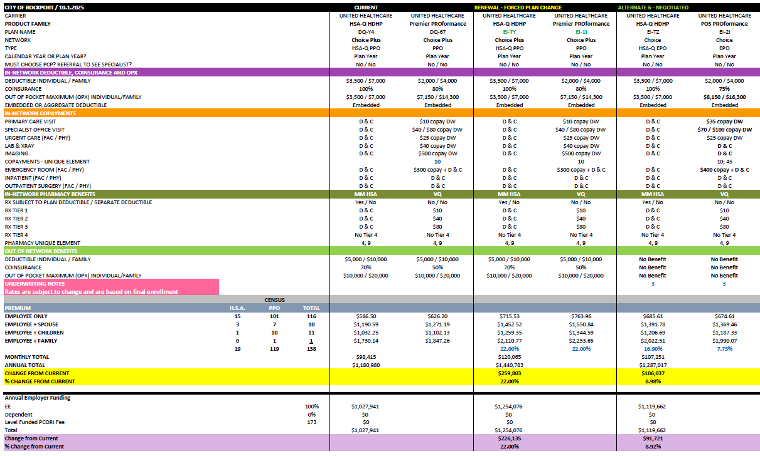

Slide 62
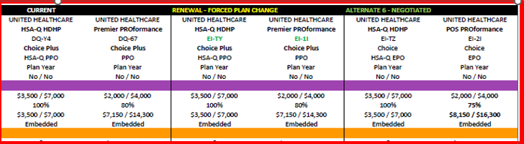
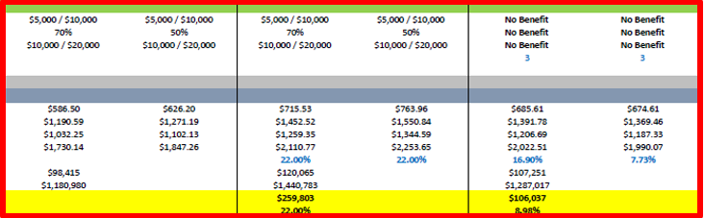

Slide 63
Budget Calendar

Slide 64
Work as a Team
Questions?
City?
Department?

Slide 65
Five-Year Capital Improvement Projects

Slide 66
Five Year Capital Improvement Projects

Slide 67
Five Year Capital Improvement Projects

Slide 68
Five Year Capital Improvement Projects

Slide 69
Five Year Capital Improvement Projects

Slide 70
Five Year Capital Improvement Projects

Slide 71
Five Year Capital Improvement Projects

